Slide 1

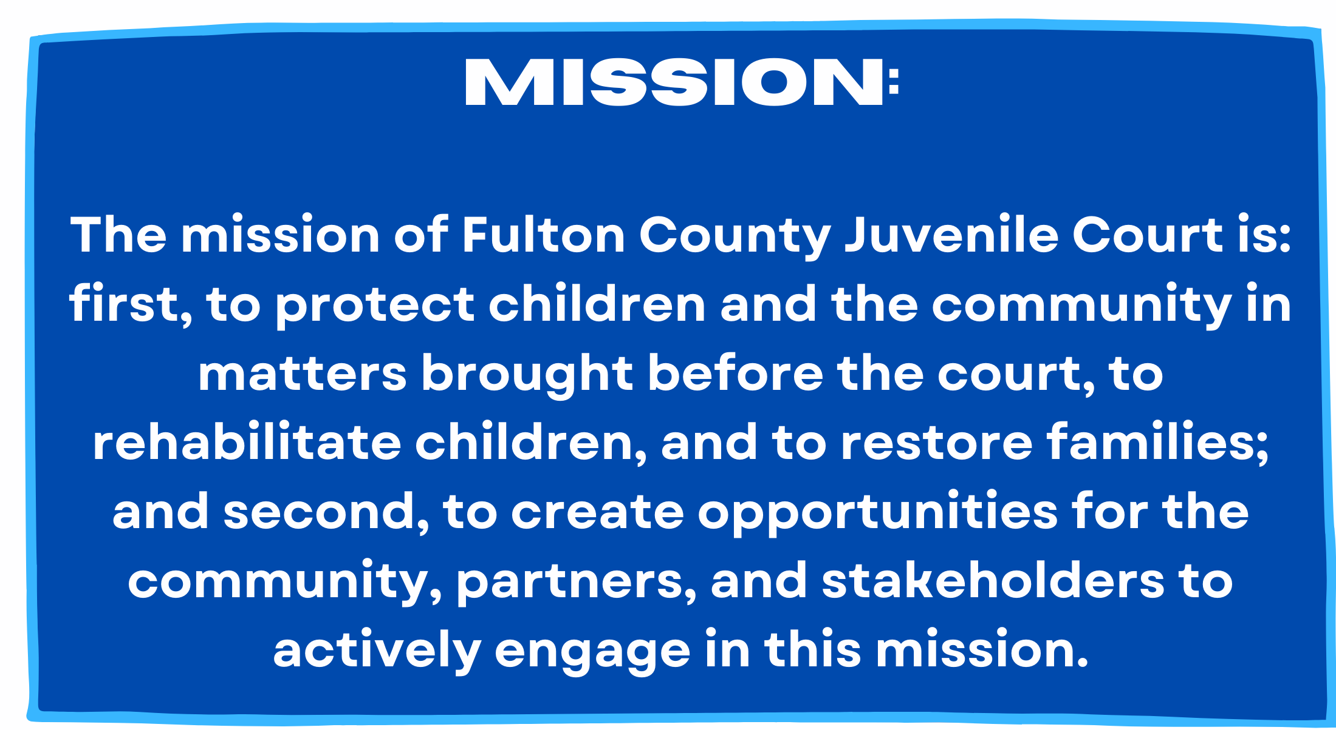
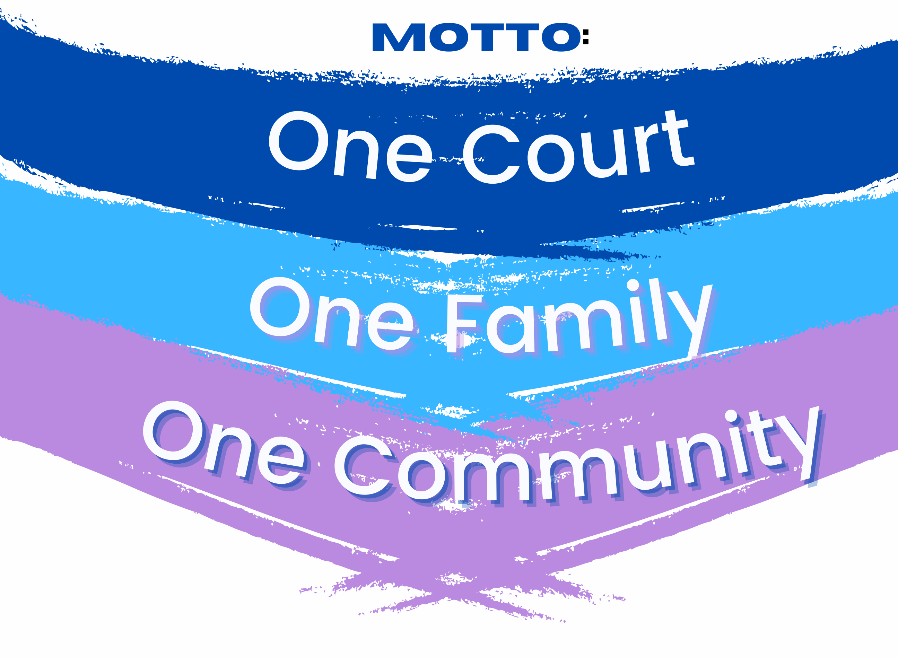
Human resources slide 1
Fulton County Juvenile Court
Teens & The Law: Recognizing Situations that Can Derail Future Success
Presented by: Lydia Toomer Popoola

Slide 2
Human resources slide 1
Introduction of Panelists
Atlanta Public School Police Department
Fulton County District Attorney’s Office
Fulton County Juvenile Court
Fulton County Solicitor General’s Office
Fulton County Sheriffs Department
Fulton County Police Department

Slide 3


Human resources slide 3
Social Media
How can social media affect you?
Chief Assistant Solicitor General, Andrea Alabi
“It was just a picture I sent”
Fulton County Juvenile Court

Slide 4
Human resources slide 3
Using one word, what do the following images and names make you think about?
Fulton County Juvenile Court

Slide 5
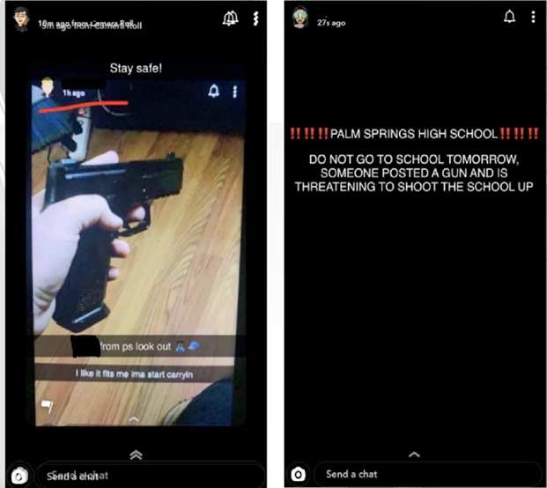
Human resources slide 4
Fulton County Juvenile Court

Slide 6
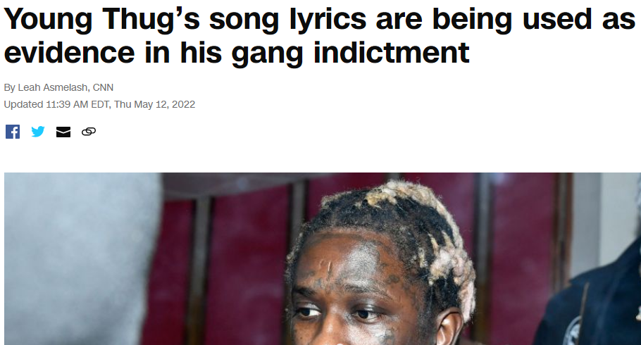
Human resources slide 4
Fulton County Juvenile Court

Slide 7
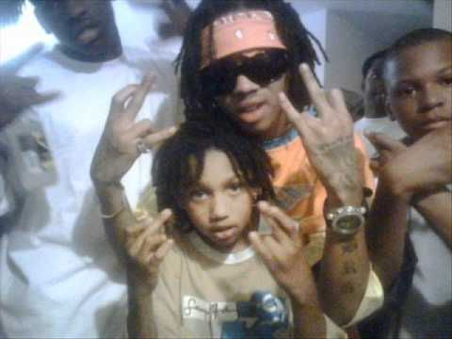
Human resources slide 5
Fulton County Juvenile Court

Slide 8
Human resources slide 3
JaMorant
Megan the Stallion & Tory Lanez
Chrisean Rock & Blueface
Fulton County Juvenile Court

Slide 9
Human resources slide 2
Social Media & You
What is a Digital Footprint
Assistant District Attorney, Jawara Mars
How long does the IG post last?
How long does the SnapChat post last?
Fulton County Juvenile Court

Slide 10
Human resources slide 3
Hypothetical # 1:
Your significant other sends you a nude pic. You share it with your friend. You said “don’t share it” but they do. The phot has been shared 3 times now.
Fulton County Juvenile Court

Slide 11
Human resources slide 6
What are some actions you as students can take to encourage more responsible social media interactions?
Fulton County Juvenile Court

Slide 12

Human resources slide 8
Do you know what House Bill 505 does?
House bill 505 makes it a felony to participate in violence during a protest.
The bill passed the House & has been recommended to the Senate Judiciary Committee.
Fulton County Juvenile Court

Slide 13
Human resources slide 10
Thank You
Fulton County Juvenile Court

Slide 14
Human resources slide 11
QUESTIONS?
Fulton County Juvenile Court

