Slide 1


Atlanta’s Careers of Tomorrow
Prepared By:
Select Fulton
October 27, 2023

Slide 2

WorkSource Fulton: Careers in IT
John McQueen
Cyber Security
Web Developers

Slide 3

WorkSource Fulton: Careers in Skilled Trades
Veda White
Bryson Barnes
Not Your Average Work Site
Countless Trades

Slide 4

WorkSource Fulton: Careers in Film
Edward LaBorde
Director/Producer

Slide 5

WorkSource Fulton
ATLWorks.Org : Central hub for Metro Atlanta’s workforce system

Slide 6
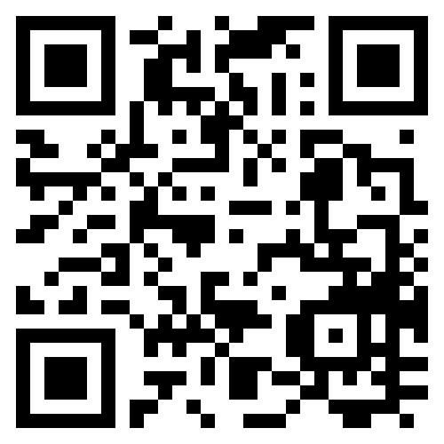
WorkSource Fulton
Michelle Vialet
Programs Manager
WorkSource Fulton
Michelle.Vialet@fultoncountyga.gov
(404) 613-0417

