Slide 1
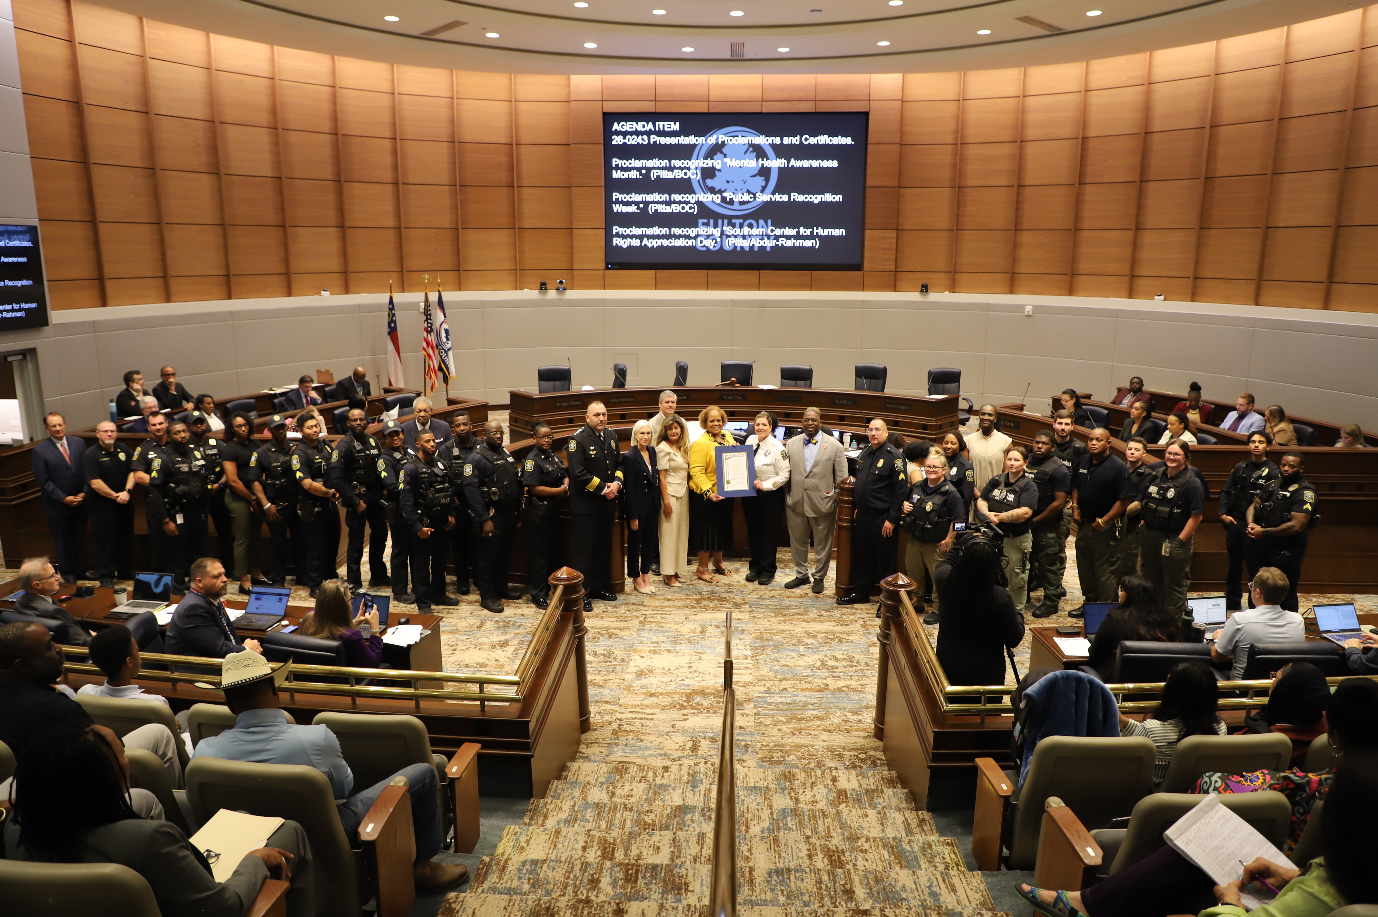
FULTON COUNTY ANIMAL SERVICES
FIELD OPERATIONS
ANIMAL WELFARE BOARD MEETING MAY 18, 2026

Slide 2
Q1 Field Operations
Field Services | January 2026 | Febuary 2026 | March 2026
Calls for Service | 1,291 | 1,221 | 1,267
Warnings Issued | 34 | 22 | 35
Citations Issued | 89 | 68 | 99
RTH | 4 | 6 | 4
Total Animals Impounded | 351 | 294 | 384
Seized Impounds | 67 | 78 | 74
Stray Impounds | 254 | 186 | 302
Surrender Impounds | 30 | 30 | 8

Slide 3

Q1 Calls for Service by Jurisdiction

Slide 4
Q1 Case Violations
Violations | Citation | Warning
Abandonment | 9 | 0
Cruelty to Animals | 7 | 2
Dog at Large | 62 | 25
Failure to Quarantine | 2 | 0
Interference | 3 | 0
Livestock at large | 3 | 1
Needs Vet care | 0 | 5
Neglect | 36 | 4
No Fulton County Tag | 22 | 1
No proof of Rabies Vaccine | 23 | 1
No visable FC tag | 3 | 0
Nuisance | 25 | 8
Violations | Citation | Warning
Nuisance-Bite | 31 | 23
Nuisance- Max # of animals | 0 | 0
Nuisance- Minimum distance Req. | 0 | 0
Nuisance- Unsanitary Conditions | 11 | 0
Special Permit | 6 | 2
Tethering | 10 | 4
Vicious Classified as Nuisance | 0 | 0
Dangerous Dog | 0 | 0
Total | 253 | 76

Slide 5
Q1 Case Violations by Jurisdiction
Jurisdiction | Citations | Warnings
Alpharetta | 4 | 2
Atlanta | 165 | 45
Chattahoochie Hills | 0 | 0
College Park | 0 | 0
East Point | 1 | 4
Fairburn | 10 | 3
Fulton County | 0 | 0
Hapeville | 0 | 0
Jurisdiction | Citations | Warnings
Johns Creek | 1 | 0
Milton | 7 | 1
Palmetto | 11 | 0
Roswell | 4 | 4
Sandy Springs | 3 | 8
South Fulton | 41 | 15
Union City | 9 | 9

Slide 6
Pending Court Cases
Impound Date | # of Animals | Status
3/3/2023 | 1 | Pending
12/3/2023 | 1 | Pending
5/31/2024 | 1 | Pending
7/6/2024 | 8 | Pending
10/24/2024 | 2 | Pending
11/7/2024 | 2 | Pending
2/13/2025 | 8 | Pending
4/17/2025 | 2 | Pending
4/19/2025 | 1 | Pending
5/27/25 | 28 | Pending/Trial 6-1
7/14/2025 | 1 | Pending
9/18/2025 | 6 | Pending
Impound Date | # of Animals | Status
11/2/2025 | 1 | Pending
11/7/2025 | 2 | Pending
11/24/2025 | 1 | Pending
12/18/2025 | 1 | Pending
12/21/2025 | 1 | Pending
12/29/2025 | 5 | Pending
1/3/2026 | 2 | Pending
2/21/2026 | 1 | Pending
3/5/2026 | 2 | Pending
3/17/2026 | 3 | Pending
Total | 80 | 17 Foster/63 Shelter

Slide 7
Staffing
Positions | Funded | Filled | Vacant
Field Services Director | 1 | 1 | 0
Field Services Managers/Supervisors | 3 | 3 | 0
Animal Services officers/Investigators | 15 | 12 | 3
Field Services Support Staff | 3 | 1 | 2
Total Field Services Staff | 22 | 17 | 5

Slide 8
March 2026 Response Times by Type/Jurisdiction
Call Types | Alpharetta | Atlanta | Chatt Hills | College Park | East Point | Fairburn | Fulton County | Hapeville
1. Dog bites or animal attacks | 00:49 | 00:37 | 00:32 | 00:43 | 00:31 | 00:56
2. Injured/Sick Animal | 00:39 | 00:37 | 00:41 |  | 00:40 | 00:33 |  | 00:35
3. Public Safety emergency calls | 01:05 | 00:35 |  | 00:31 | 00:27 | 00:58
4. Rescue | 00:58 | 00:51 |  |  | 1:48 |  | 00:13
5. Animal in trap |  | 00:36
6. Cruelty/Neglect | 1:18 | 5:59 |  |  | 15:28 | 18:53
7. Tethering |  | 4:38 |  |  | 3:28
8. Loose/Confined animals, welfare | 14:16 | 12:09 |  | 1:16 | 6:12 | 3:17 | 00:07 | 5:22
9. Follow-up, transport, special permit | 7:22 | 9:10 | 7:37 |  | 9:32 | 7:22

Slide 9
March 2026 Response Times by Type/Jurisdiction (cont.)
Call Types | Johns Creek | Milton | Palmetto | Roswell | Sandy Springs | South Fulton | Union City
1. Dog bites or animal attacks | 00:56 | 00:54 |  | 1:18 | 1:08 | 00:35 | 00:39
2. Injured/Sick Animal | 00:44 | 1:52 |  |  | 00:53 | 00:42 | 00:22
3. Public Safety emergency calls | 00:22 |  | 00:47 | 1:21 | 00:45 | 00:41 | 00:43
4. Rescue |  |  |  |  |  | 1:03
5. Animal in trap |  |  |  |  | 00:53 | 1:58
6. Cruelty/Neglect | 1:11 | 1:24 |  | 1:25 | 13:53 | 6:19 | 10:45
7. Tethering |  |  |  |  |  | 9:31 | 9:23
8. Loose/Confined animals, welfare | 17:26 | 9:08 | 11:59 | 15:31 | 6:52 | 12:07 | 21:23
9. Follow-up, transport, special permit | 6:48 | 7:39 | 16:14 | 11:52 | 4:21 | 12:14 | 11:01

Slide 10
Q1 Calls for Service Per Capita
Jurisdiction | Per 1,000 Residents
Alpharetta | 0.85
Atlanta | 4.13
Chattahoochee Hills | 8.47
College Park | 1.79
East Point | 5.34
Fairburn | 6.79
Hapeville | 1.22
Johns Creek | 0.52
Milton | 0.85
Palmetto | 6.51
Roswell | 0.88
Sandy Springs | 1.18
South Fulton | 6.38
Union City | 6.49

