Slide 1

Animal Welfare
Board Meeting
May 18, 2026

Slide 2
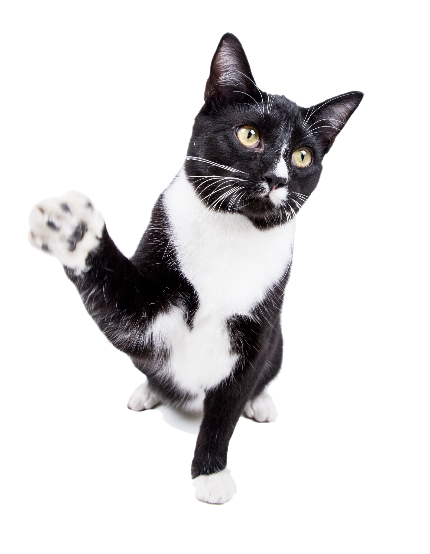
2026 Shelter Intake
Q1 2026
1781
928
853
1192
262
605
503
102
2423
Q1 2025
1588
871
717
1100
200
415
367
48
2018
Intake Type | Jan 2026 | Feb 2026 | Mar 2026
Total Dogs | 622 | 535 | 624
*Dog Intake OTC | 321 | 289 | 318
*Dog Intake Field | 301 | 246 | 306
*Dog Intake Lost | 416 | 349 | 427
*Dog Intake Owner Surrender | 102 | 78 | 82
Total Cats | 151 | 218 | 236
*Cat Intake OTC | 124 | 185 | 194
*Cat Intake Field | 27 | 33 | 42
Intake Total (including Other) | 784 | 768 | 871
Percentage Change
12.15%
6.54%
18.97%
8.36%
31.00%
45.78%
37.06%
112.50%
20.07%

Slide 3
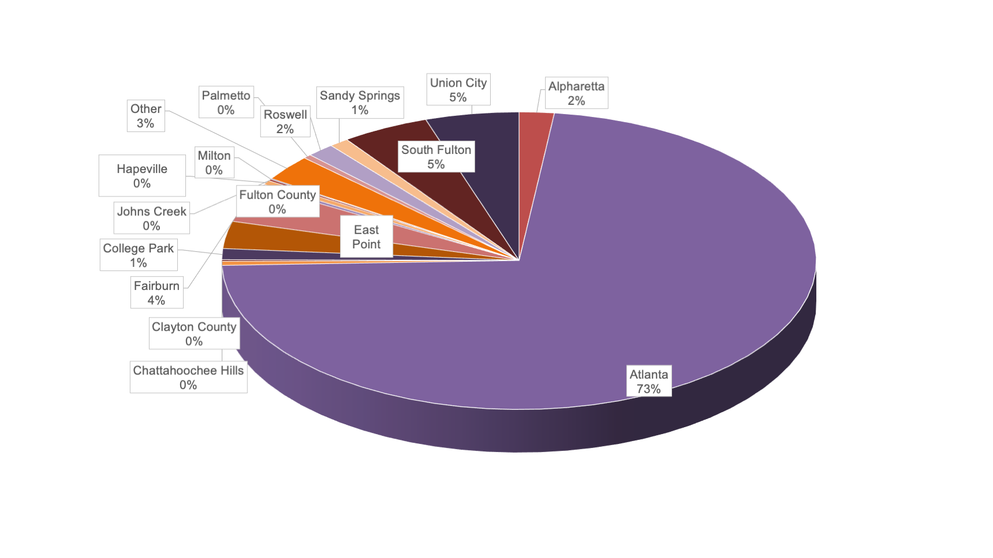

Q1 2026 Intake by Jurisdiction

Slide 4
2026 Intake Per Capita
Jurisdiction | Per 1000 Residents
Alpharetta | 0.6
Atlanta | 3.1
Chattahoochee Hills | 2.7
College Park | 1.9
East Point | 1.8
Fairburn | 5.2
Hapeville | 1.6
Johns Creek | 0.0
Milton | 0.0
Palmetto | 1.9
Roswell | 0.4
Sandy Springs | 0.2
South Fulton | 0.9
Union City | 4.0

Slide 5
2026 Shelter Outcomes
Outcome Type | Jan 2026 | Feb 2026 | Mar 2026
Adoptions: Dogs | 355 | 354 | 360
Adoptions: Cats | 137 | 93 | 65
Total FCAS Adoptions (all animals) | 502 | 447 | 427
RTH (total animals) | 107 | 73 | 118
RTH (of lost dog intakes) | 71 | 50 | 63
Transfers/Rescue (not including to LifeLine) | 191 | 144 | 132
Transfers/Rescue (including to LifeLine) | 247 | 225 | 204
TNR | 16 | 39 | 27
Died (all animals) | 12 | 1 | 8
Euthanized | 63 | 26 | 48
Other (Missing/Admin Missing) | 4 | 3 | 1
Total Outcomes | 957 | 824 | 837
Save Rate | 89.8% | 96.0% | 93.4%
Q1 2026
1069
295
1376
298
184
467
676
82
21
137
8
2618
93.1%
Percentage Change
21.34%
18.95%
21.45%
9.16%
15.00%
8.35%
14.58%
46.43%
110.00%
-23.46%
60.00%
15.48%
2.98%
Q1 2025
881
248
1133
273
160
431
590
56
10
179
5
2267
90.4%

Slide 6
2026 Avg Length of Stay
Outcome Type | Jan 2026 | Feb 2026 | Mar 2026
Adoption Dog | 26.0 | 24.8 | 26.8
Adoption Cat | 10.3 | 12.0 | 9.4
Return-to-Home Dog | 5.5 | 9.8 | 5.4
Return-to-Home Cat | 3.1 | 3.0 | 7.0
Q1 2025
34.5
11.1
8.3
2.4
Q1 2026
25.9
10.6
6.5
5.5
This includes all animals and represents only the days/time spent in the shelter.
Species | Jan 2026 | Feb 2026 | Mar 2026
Foster Dog | 79.5 | 89.8 | 66.6
Foster Cat | 76.8 | 67.1 | 29.3
Q1 2025
100.2
64.5
Q1 2026
78.6
61.2
This includes only animals who spent time in foster and represents the animal’s entire Length of Stay.

Slide 7
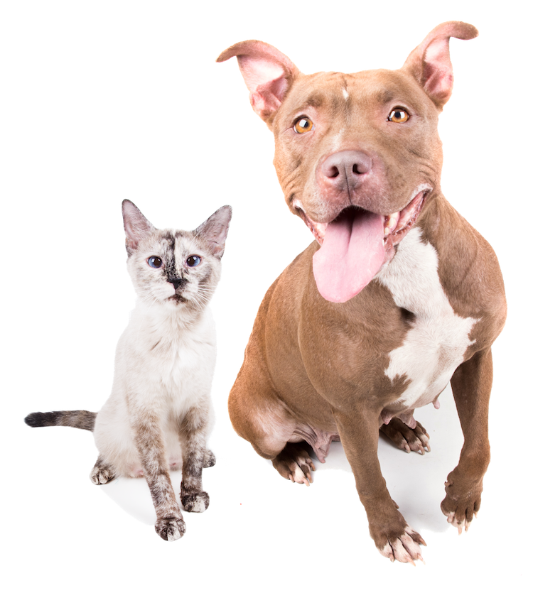
2026 Foster Program
Foster Program | Jan 2026 | Feb 2026 | Mar 2026
# Dogs Went Into Foster | 390 | 260 | 351
# Cats Went Into Foster | 62 | 48 | 101
Total Pets Who Went Into Foster | 452 | 308 | 452
Friendly Finders who continued fostering | 0 | 8 | 2
Q1 2026
1001
211
1212
10
Q1 2025
912
83
995
17

Slide 8
2026 Vet Services - Public Clinic
Vet Services – Public Clinic | Jan 2026 | Feb 2026 | Mar 2026
Clients | 76 | 60 | 77
Pets | 93 | 70 | 101
Vaccinations | 167 | 160 | 217
Microchips | 2 | 2 | 2
Q1 2025
217
254
482
16
Q1 2026
213
264
544
6

Slide 9

2026 Volunteer Program
Volunteers | Jan 2026 | Feb 2026 | Mar 2026
In-Shelter Volunteer Hours | 1921 | 1444 | 2003
Remote Volunteer Hours | 38 | 176 | 172
Volunteer Groups | 1 | 5 | 4
Individual Volunteers within Groups | 13 | 83 | 86
Volunteer Group Hours | 26 | 166 | 258
Total Active Volunteers | 132 | 100 | 101
Total Volunteer Hours | 1959 | 1620 | 2175
Q1 2026
5368
386
10
182
450
153
5754
Q1 2025
2841
317
6
77
154
unavailable
3158

Slide 10



Q1 2026 Adoption Promotions
Upcoming Promotions: Take ‘Em Home Tuesday – Free dog adoptions every Tuesday thru summer), Adopt a Shelter Pet Day – Free adoptions Apr 30-May 3.

Slide 11
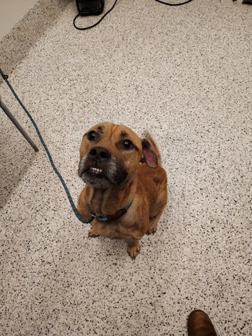
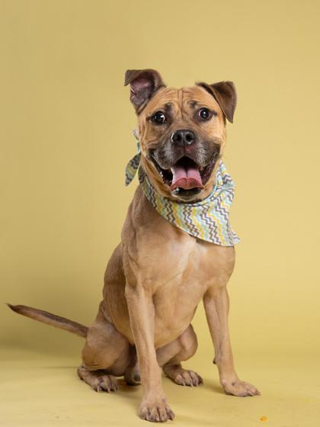
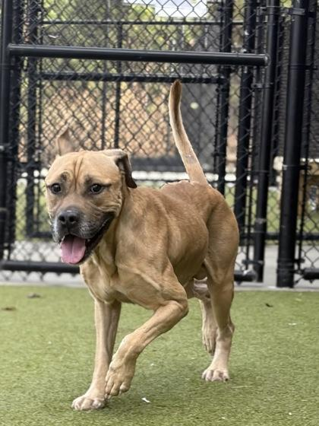
Ryder A0060238116
Ryder A0060238116
Ryder is a delightful 6-year-old pup who is ready to find his forever home! This sweet boy has spent far too long at the shelter, and he’s hoping to change that soon. One of Ryder's most endearing traits is his charming wiggle! Whenever anyone approaches his kennel, he can't help but wiggle his butt in excitement, showing just how much he loves attention and affection. He thrives on companionship and is looking for a loving family to shower him with love and cuddles.
Ryder is a gentle soul who deserves a second chance at happiness. If you’re ready to welcome a loyal friend into your life, come meet Ryder and experience his joyful spirit firsthand. Let’s help this lovable guy find the loving home he’s been waiting for! 🐶❤️
Ryder does well with others in playgroup.

Slide 12
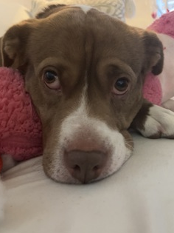
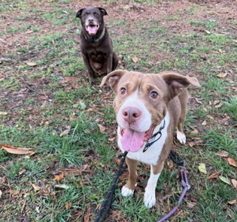
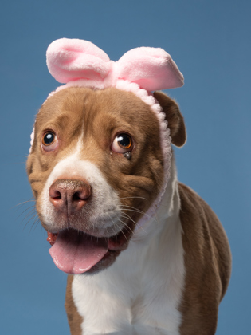
LIZ A0059562812
Meet Liz (aka Lizzy)
As a self-proclaimed cat lady, I can confidently say Lizzy has made fostering a dog an absolute breeze.
Liz is a true match-your-energy kind of girl. Want to lounge on the couch all day? She’s in. Feeling adventurous and ready to get out of the house? She’s down for that too. Inside the home, Liz is generally calm and low-energy—until you grab her leash. Then she does the cutest little happy dance that will instantly make your day.
Liz knows her basic commands (sit, paw, stay) and is crate trained, though she’s never been destructive in the home. She’d happily snuggle in bed with you, but she’s just as content heading to her crate when asked. Easygoing and adaptable is her specialty.
She shows affection in sweet, thoughtful ways—but she is not a licker. If you’re not into dog kisses, Liz might be your perfect match. Want her closer during cuddle time? Just say “come here,” and she’ll gently crawl her little face right up to yours.
Liz plays gently with her toys and loves fetch, though she doesn’t always want to give the ball back. A simple treat trade (tossed away from the toy) works perfectly, and she happily complies. She can be a bit protective of her toys if she thinks someone wants to take them, sometimes showing stiffness or a quiet growl, so she’d benefit from continued training around resources. Because of this, Liz would likely do best with older children who can respect her cues.
She does well in the car and usually settles right into the backseat unless she’s extra excited.
She’s gone on multiple doggie dates and walks and has done great each time—sometimes playful, sometimes happily doing her own thing. Slower, thoughtful introductions are recommended, but she’s clearly shown she enjoys canine company.
Liz is truly something special. She’s an incredibly easy, low-maintenance pup with a few manageable quirks, and she has so much love to give to the right home.
Liz is around 6 years old and weighs 47 lbs.

