Slide 1
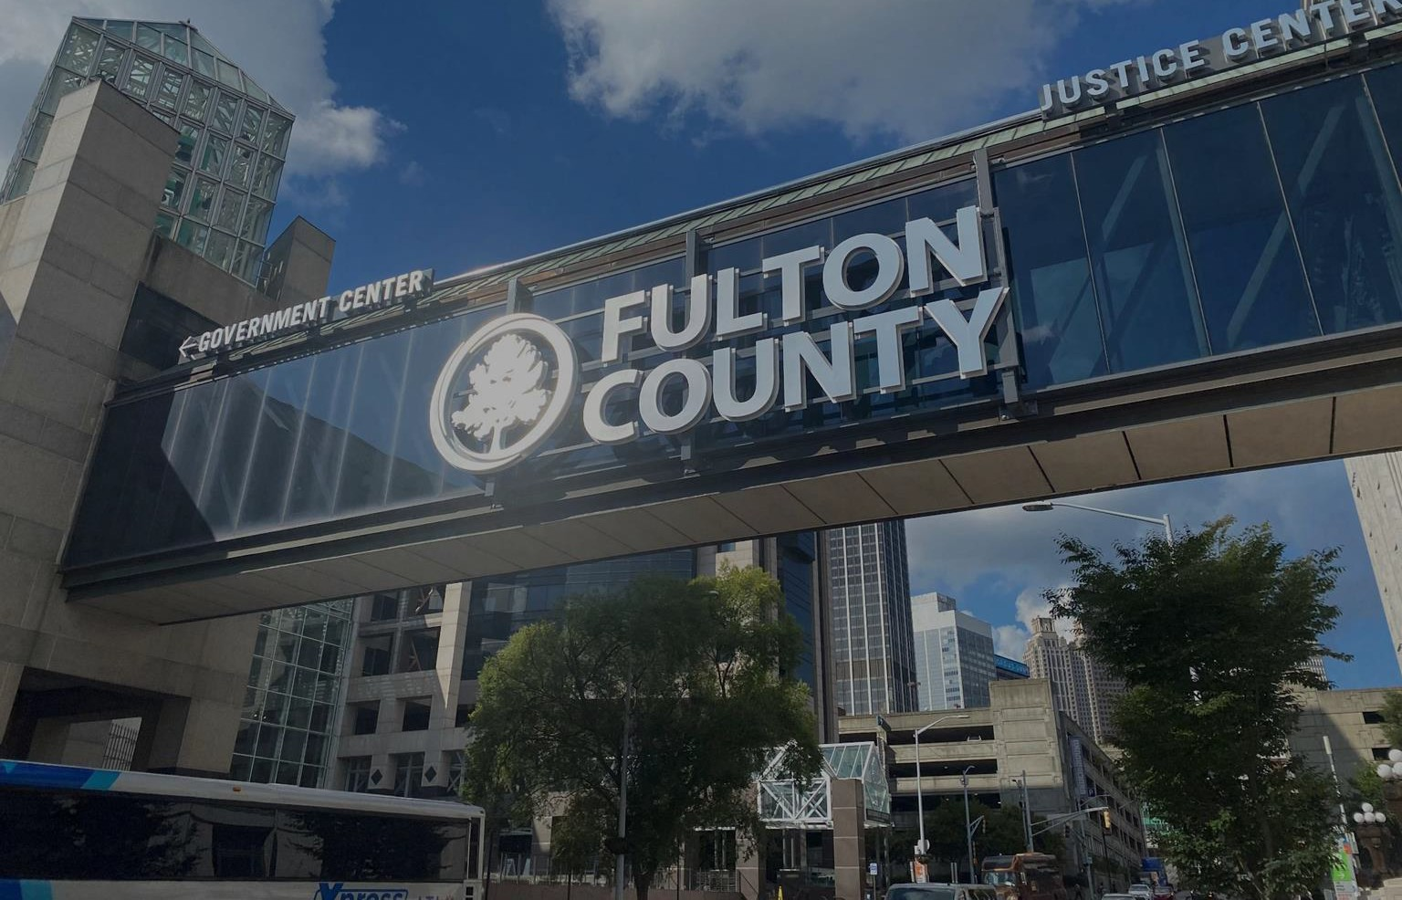
Fulton County Operational Report
January 24, 2024
Board of Commissioners Meeting
1

Slide 2
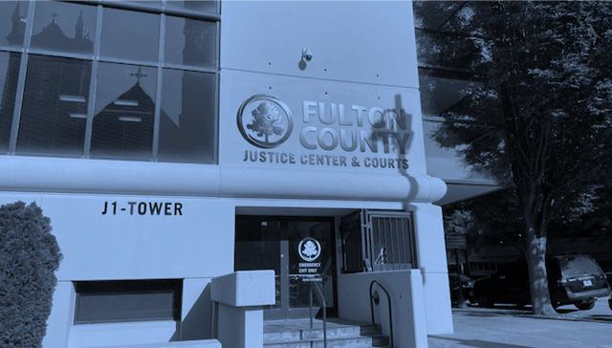

Project ORCA
FULTON COUNTY GOVERNMENT
& Justice System Update
JANUARY 24, 2024
AGENDA
01
O R C A C A S E R E D U C T I ON
C U M U L AT I V E CASE R E D U C T I O N
02
03
JAIL P O P U LAT I O N U P D AT E
18

Slide 3

Project O v e r v i e w
Case Accumulation Defined
All cases (hearings, filings, applications) that were initiated before and during the pandemic (including those currently awaiting formal charging or filing) that have been impacted due to current limitations at various stages of the case administration process.
Since the beginning of COVID-19, the Fulton County Court System has amassed a significant and unprecedented level of cases. Project ORCA will address this challenge by utilizing a combination of capacity expansion and productivity enhancement initiatives to expedite the case adjudication process.
The COVID-19 Case Resolution Project began
on December 6, 2021 with 148,209 open and active cases.
As of December 31, 2023, 126,560 cases have been disposed.
There are 21,649 pending open and active cases.

Slide 4
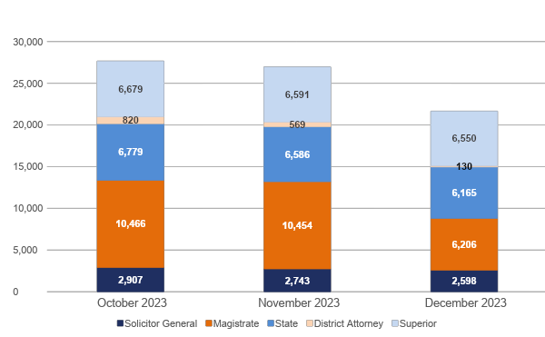
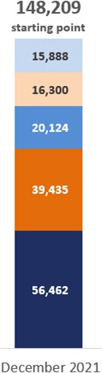
P R O J E C T O R C A C A S E R E D U C T I O N
Dispositions by Office
126,560
cases disposed
27,651
26,943
21,649
708
5,294

Slide 5
P R O J E C T O R C A C A S E R E D U C T I O N
Case Disposition S u m m a r y
Office | December 2023 (Last full month) |  |  |  | Project To Date (12/6/2021 through 12/31/2023)
 | Target | Actual |  | Variance | Target | Actual | Variance
Superior | 442 | 198 |  | (244) | 11,034 | 14,193 | 3,159
District Attorney | 356 | 439 |  | 83 | 10,382 | 16,170 | 5,788
State | 556 | 479 |  | (77) | 13,900 | 17,316 | 3,416
Solicitor General | 1,540 | 145 |  | (1,395) | 38,500 | 53,487 | 14,987
Magistrate | 1,091 | 4,238 |  | 3,147 | 27,275 | 33,222 | 5,947
Overall | 3,985 | 5,499 | 1,514 |  | 101,091 | 134,388 | 33,297

Slide 6
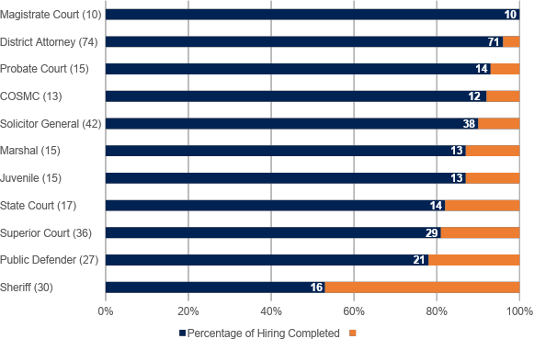
Hiring Progress
Hiring Progress by Department As of 1/1/2024
Since 12/4/2023
-
-
-
+1
+3
-
-1
+2
+1
-1
-

Slide 7
Project ORCA
FULTON COUNTY GOVERNMENT
& Justice System Update
JANUARY 24, 2024
AGENDA
01
O R C A C A S E R E D U C T I O N
C U M U L A T I V E C A S E R E D U C T I O N
JAIL P O P U L AT I O N U P D A T E
02
03
23

Slide 8
C U M U L A T I V E C A S E R E D U C T I O N
JUST I CE SYST E M S C O R E C A R D
MEASURE | GOAL | MAY 2023 BASELINE | DECEMBER 2023 | DELTA (current month vs. baseline)
Average Length of Stay | 30 days | 71 days | 61 days | 10 day decrease
Jail Population Unindicted without other charges | 10% | 34% | 24% | 10% decrease (557 less unindicted)
Clearance Rate for Felony Criminal Cases | 100% | 72% | 52% | 20% decrease
Felony Cases Disposed within 180 Days | 90% | 25% | 35% | 10% increase
Felony Cases Disposed within 365 Days | 98% | 63% | 68% | 5% increase
24

Slide 9
Project ORCA
FULTON COUNTY GOVERNMENT
& Justice System Update
JANUARY 24, 2024
AGENDA
01
ORCA CASE REDUCTION
CUMULATIVE CASE REDUCTION
JAIL POPULATION UPDATE
02
03

Slide 10
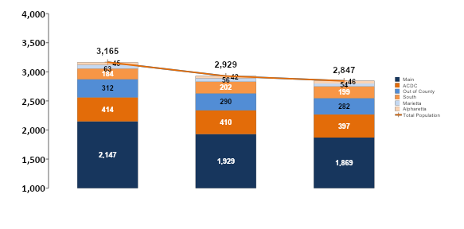
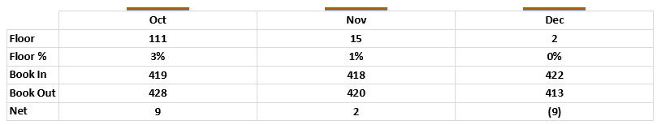


Average Monthly Population
2,743
as of 1/16/2023
26

Slide 11
Average Monthly Jail Population
Population by facility
 | OCTOBER | NOVEMBER | DECEMBER | 1/16/2023
Main | 2,147 | 1,929 | 1,869 | 1,737
ACDC | 414 | 410 | 397 | 409
Out of County | 312 | 290 | 282 | 309
South Annex | 184 | 202 | 199 | 195
Marietta | 63 | 56 | 54 | 60
Alpharetta | 45 | 42 | 46 | 33
TOTAL | 3,165 | 2,929 | 2,847 | 2,743

Slide 12
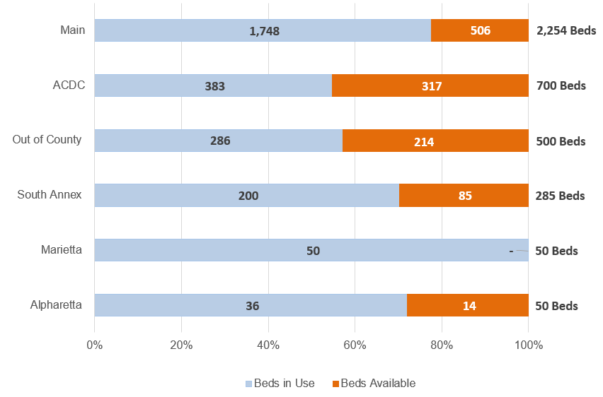
Jail Population
facility utilization AS OF 12/31/2023

Slide 13
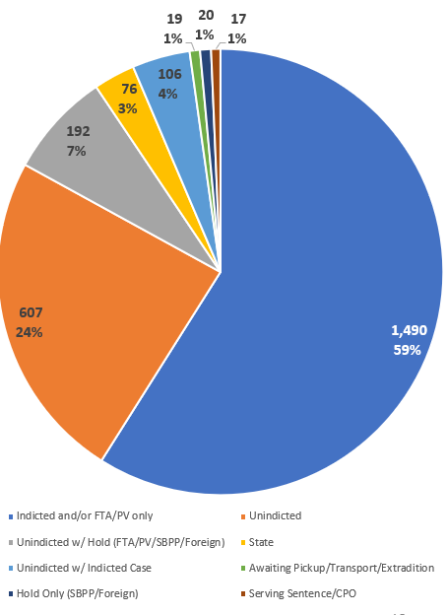
JAIL P O P U L A T I ON
FULL I N M ATE ANALYSIS As of 1/5/2024
Status | Number of Inmates
Unindicted | 607 | 24%
Unindicted w/ Hold | 192 | 7%
Unindicted w/ Indicted Case | 106 | 4%
Indicted (DA) | 1,490 | 59%
Accused (SG) | 76 | 3%
Hold Only (SBPP/Foreign) | 20 | 1%
Awaiting Pickup/Transport/Extradition | 19 | 1%
Serving Sentence/CPO | 17 | 1%
TOTAL | 2,527 | 100%

Slide 14
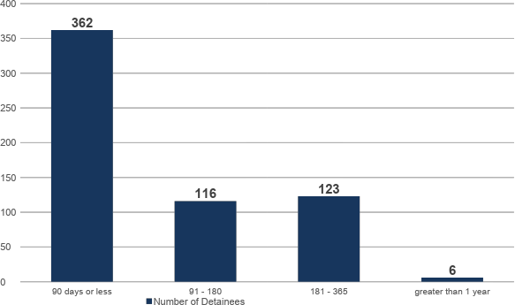
U N I N D I C T E D J A I L P O P U L A T I O N
DAYS IN JAIL As of 1/5/2024
Excludes detainees with pending indicted cases and holds (Probation Violations, Failure to Appears and foreign and/or other agency holds).

Slide 15
Ankle Monitor Updates
Updated 1/18/2024
CAP set by BOC Action:
Current # of Ankle Monitors: Request for Proposal Issued: Pre-proposal Meeting:
Q&A Deadline: Proposal Due Date:
Tentative Oral Presentations:
Anticipated BOC Meeting: Owner of the Program:
1518
1310
December 13, 2023
January 8, 2024
January 17, 2024
January 24, 2024 February 8th -9th, 2024 March 6, 2024
Superior Court

Slide 16
P R I O R I T I E S
✔ Accelerate ORCA case resolution/performance
✔ Implement multi-agency jail reduction plan
✔ Prevent Post-ORCA backlog
✔ 2024 Look ahead…
Closeout Project ORCA
Continue ORCA & justice system tracking and reporting
Shift primary discussion of performance to Justice Partners

Slide 17
Justice System Dashboards
public information
JUSTICE SYSTEM DASHBOARDS
DEPARTMENT | PUBLICLY AVAILABLE DASHBOARDS
SUPERIOR COURT | Total Defendants in Jail (Complex)
 | Defendants in Jail for Over 1 Year (Complex)
 | Total Pending Cases (Complex)
 | Cases Pending for Over 1 Year (Complex)
 | Total Defendants in Jail (Non-Complex)
 | Defendants in Jail > 180 Days (Non-Complex)
 | Total Pending Cases (Non-Complex)
 | Cases Pending > 180 Days (Non-Complex)
NATIONAL COURT STANDARDS | Time to Disposition (Felony)
 | Time to Disposition (Civil)
 | Time to Disposition (Family)
 | Clearance Rates
 | Aging of Cases
STATE COURT | Total Defendants in Jail (Misdemeanor)
 | Defendants in Jail Over 1 Year (Misdemeanor)
 | Total Pending Criminal Cases
 | Criminal Cases Pending for Over 1 Year
PROJECT ORCA DASHBOARDS
DEPARTMENT | PUBLICLY AVAILABLE DASHBOARDS
OVERALL | Total Disposed Cases
 | Remaining Open & Active Cases
COURTS | Total Disposed Cases & Filings
 | Remaining Open & Active Cases & Filings
PROSECUTORS | Total Disposed, Indicted, or Accused Cases
 | Remaining Open & Active Cases
All publicly available justice system data and dashboards are found at:
https://fultoncountyga.gov/inside-fulton-county/open-government

Slide 18
QUESTIONS

Slide 19
Jail Bridging Plan

Slide 20
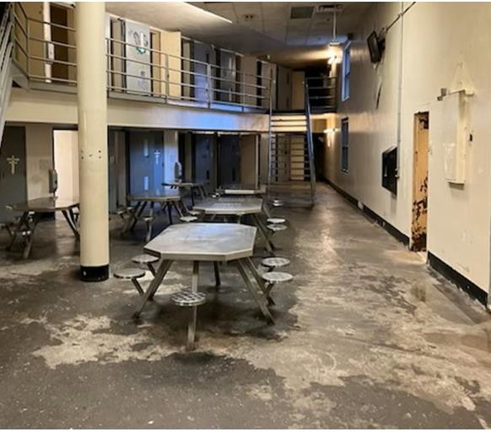
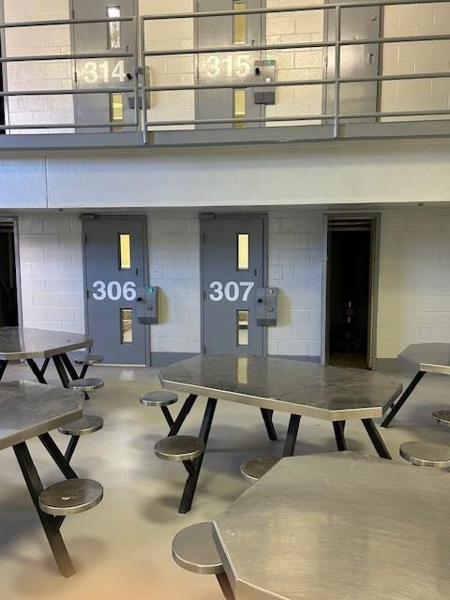
Jail Maintenance and Repairs
Before
After
36

Slide 21
Jail Maintenance and Repairs
1st Blitz Unit (1 North) completed 11/6/23, (3 months to
complete).
2nd Blitz Unit (2 South) completed 12/26/23, conducted walk through with Sheriff and returned to service (6 weeks to complete).
3rd Blitz Unit (4 North) began 1/2/24 heavy damage, (expected completion 6 to 8 weeks). Currently 49% complete.
Additionally, there are 170 cells being repaired that unavailable for use due to non-blitz related items and should be returned to service in 8 weeks.
37

Slide 22
Jail Maintenance and Repairs
Complete Jail Survey: December 18th, Sheriff convened a leadership team to inspect every unit in the Rice St Jail.
Sheriff's Team will complete jail walk through / survey every 3 months.
Also, Contractor (JCI), is conducting detailed weekly surveys
22

Slide 23
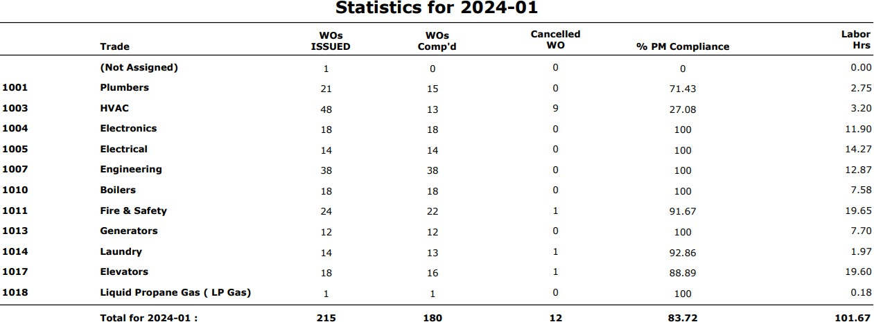
Jail Maintenance and Repairs
95% of work orders are completed within 36 hours
Statistics for January 2024
23

Slide 24
QUESTIONS

