Slide 1


Department of Finance
Payroll Division
NEW HIRE ORIENTATION
PRESENTATION
Presented By: Tomekia Mance (404) 612-7668
Charles Lipede (404) 612-7674
Notes:
Welcome, and thank you for attending. This presentation is brought to you by the Department of Finance, Payroll Division. The topics that we are going to discuss are filling out the Direct Deposit and Pay card form, Credit Union deductions, Payroll Cancellations, Federal and State Tax Deductions, and Transportation employee discount offerings.

Slide 2
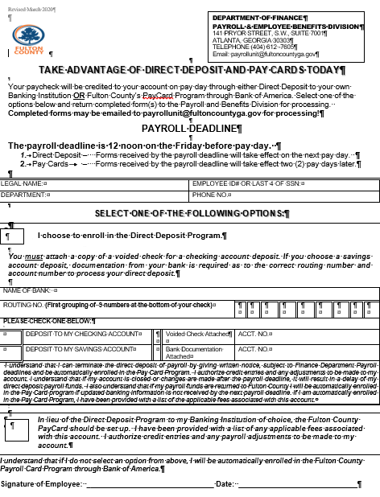
DIRECT DEPOSIT & PAYROLL CARD
Employees’ Payroll Funds will be credited on Pay Day through Direct Deposit to your personal bank OR via Fulton County Payroll Card through Bank of America.
Notes:
If you wish to enroll in Direct Deposit, you’ll complete the Take Advantage of Direct Deposit and Pay Card form and the following is required:
--check in the box “I choose to enroll in the Direct Deposit Program”
--complete your name, employee id, department and phone number
--you’ll choose either checking or savings account number and you’ll fill in the routing number and account number
-- you must include either a voided check or bank documentation with your account number listed
--you must sign and date the form
If you wish to enroll in Pay card Program, you’ll complete the Take Advantage of Direct Deposit and Pay Card form and the following is required:
--check in the box “In lieu of the Direct Deposit Program to my Banking Institution of choice, the Fulton County PayCard should be set up. I have been provided with a list of any applicable fees associated with this account. I authorize credit entries and any payroll adjustments to be made to my account”
--you must sign and date the form
If you don’t select an option, after receiving two pay checks in a row, Fulton County will automatically enroll you in the Pay card program

Slide 3
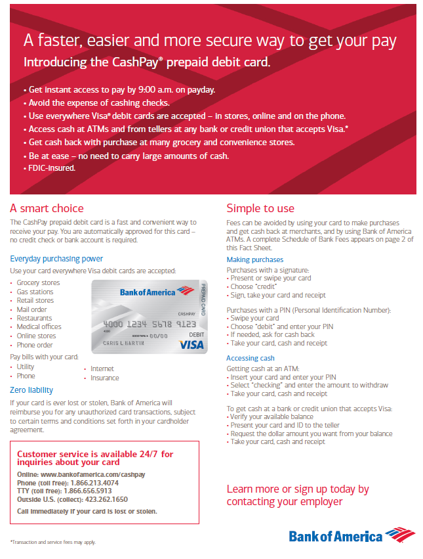
HOW TO USE YOUR PAYROLL CARD
Notes:
This slide provides additional information regarding the Paycard program.
The CashPay prepaid debit card is a fast and convenient way to receive your pay. You are automatically approved for this card – no credit check or bank account is required.
The benefits include:
Get instant access to pay by 9:00am on payday
Avoid the expense of cashing checks
Use everywhere Visa debit cards are accepted – in stores, online and on the phone
Access cash at ATMs and from tellers at any bank or credit unions that accepts VISA
Get cash back with purchase at many grocery and convenience stores
Be at ease – no need to carry large amounts of cash
FDIC-insured
Customer service is available 24/7 for inquires about your card:
Online: www.bankofamerica.com/cashpay
Phone (toll free): 1-866-213-4074

Slide 4
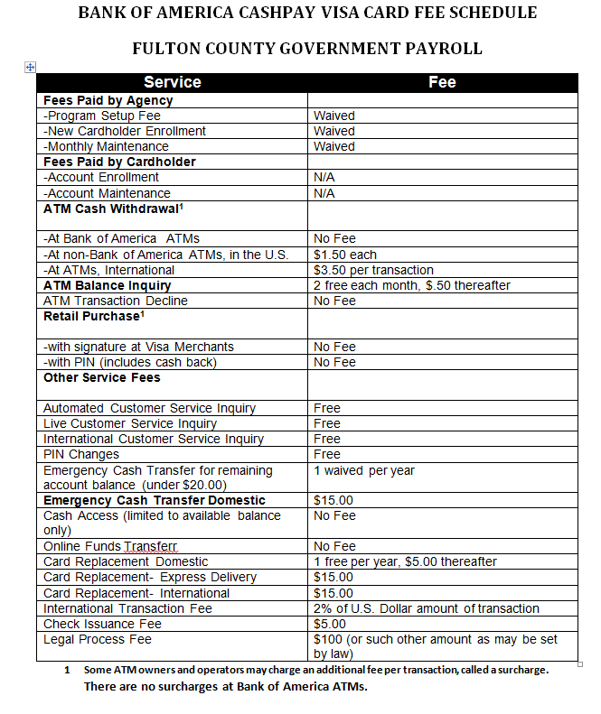
PAYROLL CARD FEE SCHEDULE
Notes:
This slide provides the fee schedule for the Pay Card. If you have any questions, please contact Bank of America with the contact information that was provided in the previous slide.

Slide 5

CREDIT UNIONS
CREDIT UNIONS
* ASSOCIATED CREDIT UNION
6789 Peachtree Industrial Blvd.
Atlanta, Georgia 30369
(770) 448 - 8200
* EXCEL FEDERAL CREDIT UNION
5070 Peachtree Industrial Blvd.
Norcross, Georgia 30071-1550
Main Office (770) 441 9235
Atlanta Federal Center
(404) 524 – 2780
The above Credit Unions are also located downtown in the Atlanta Federal Center at:
61 FORSYTH STREET S.W ATLANTA
* CREDIT UNION OF ATLANTA
670 Metropolitan Parkway
Atlanta, Georgia 30310
(404) 658 - 6465
Credit Union of Atlanta/ Wheat St. Branch
375 Auburn Avenue
Atlanta, Georgia
(404) 222 - 0686

Slide 6
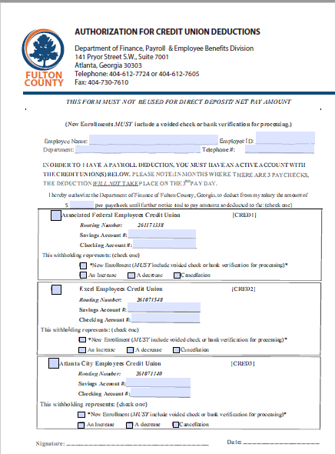
CREDIT UNION DEDUCTION FORM
Notes:
If you wish to have you have a portion of your net pay to go to one of the credit unions, you’ll need to complete the Authorization for Credit Union Deductions form.
You must enter your name, Employee ID, Department Name and Telephone number.
You also need to include the amount you want deducted for each payday
You’ll select with Credit Union and you’ll enter the account number for the credit union that is being deducted. On the “This withholding represents” section, you’ll choose the following:
New Enrollment (New enrollments must include either a void check or bank documentation for processing)
An Increase
A decrease
Cancellation
This form must be signed and dated for processing.

Slide 7
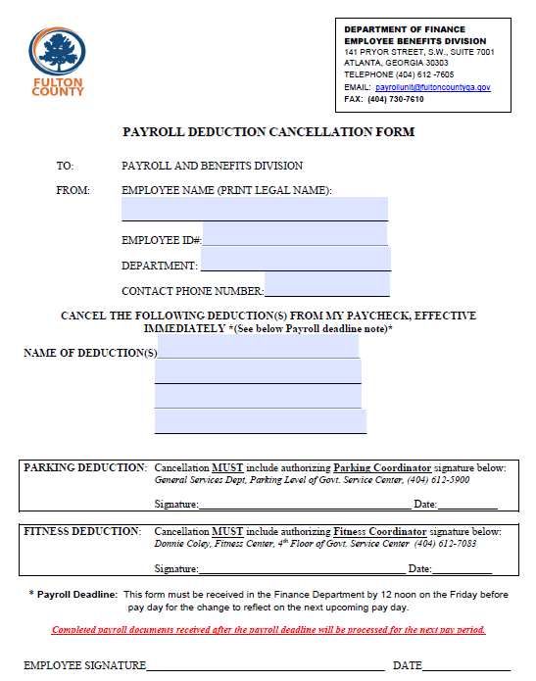
PAYROLL DEDUCTION CANCELLATION FORM
Payroll Deadline:
This form must be received in the Finance Department by 12 noon on the Friday before pay day for the change to reflect on the next upcoming pay day.

Slide 8
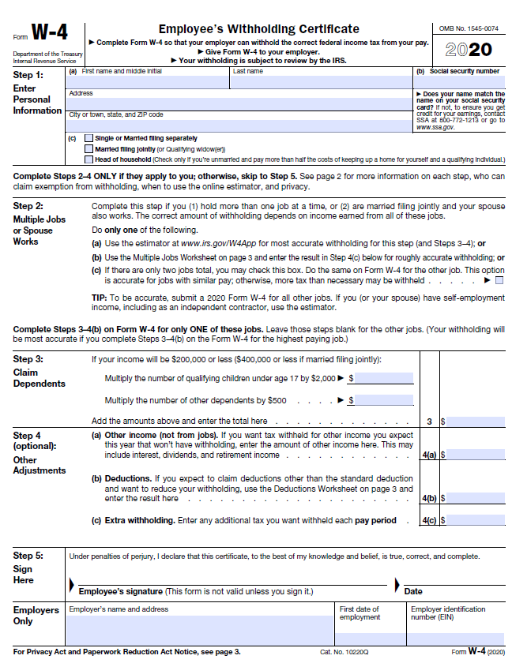
FORM W-4 FEDERAL TAXES
Form W4: Federal Withholding/Allowance Form
Notes:
Form W4 determines the amount that is going to be deducted for Federal Taxes.
Step 1: Personal Information: you must complete the following:
(a) First Name and Middle initial
Last Name
Address
City, State and Zip code
(B) full Social Security Number
(C) Select Martial Status
Complete Steps 2–4 ONLY if they apply to you; otherwise, skip to Step 5.
Step 2: Read from Form…

Slide 9
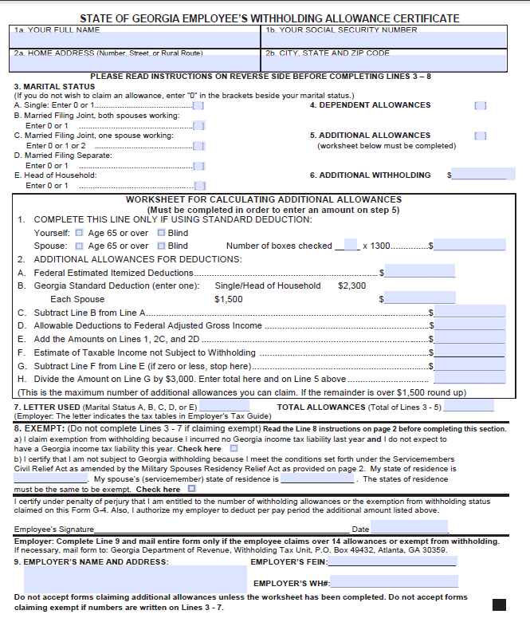
FORM G-4 STATE TAXES
Form G4: State of GA Withholding/Allowance Form

Slide 10

MARTA
Marta Payroll Deduction is $63.18 per month. This deduction is taken from the 1st check of the month, is paid one month in advance and requires 30 days notice to start and stop the deduction.
.

Slide 11

GRTA / XPRESS
GRTA Payroll Deduction are $83.75/month for Blue Zone riders & $67.00/month for Green Zone riders. This deduction is taken from the 1st check of the month, is paid one month in advance and requires 30 days notice to start and stop the deduction.

Slide 12

COBB
Cobb Payroll Deduction is $83.75/month. This deduction is taken from the 1st check of the month, is paid one month in advance and requires 30 days notice to start and stop the deduction.

Slide 13
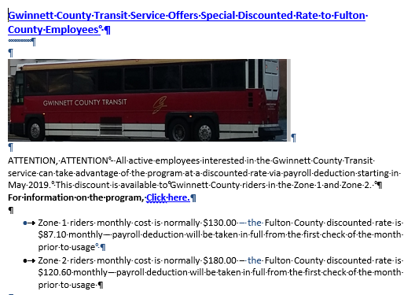
GWINNETT COUNTY TRANSIT
Gwinnett Payroll Deduction are $87.10/month for Zone 1 and 120.60 / month for Zone 2. This deduction is taken from the 1st check of the month, is paid one month in advance and requires 30 days notice to start and stop the deduction.

Slide 14
FEATURES OF ESS
ESS Allows You To View:
ESS Allows You To Update:
  Paycheck Stubs
  W-2 Tax Forms
  Pay Summary
  Deduction Summary
  Personal Information
  Address
  Emergency Contact
  Tax Withholding/ Allowances
  Downloadable Payroll Forms
  Emergency Contact Information
Notes:
ESS is the Employee Self Service System.

Slide 15
BENEFITS OF ESS
Real Time information with 24 hour access from anywhere there is an internet connection.
Ability to view, print, save Pay Stubs, W-2s & Payroll Forms.
Access to paycheck information is guaranteed to be available no later than pay day.

Slide 16
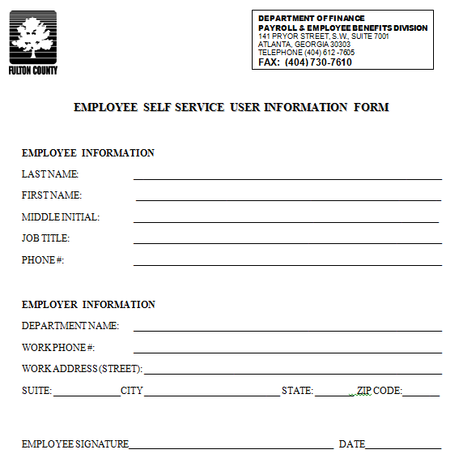
ESS USER FORM
Complete & return form to me.

Slide 17
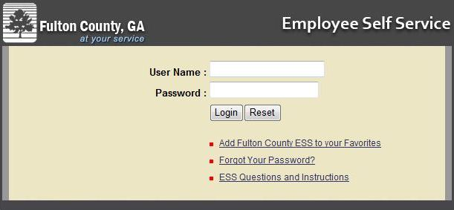
ACCESSING THE SYSTEM
Log into ESS at http://ess.fultoncountyga.gov
Fully compatible with IE 7-9 and Firefox v2.
Will work other browsers, but some minor functionalities might not work properly.

Slide 18
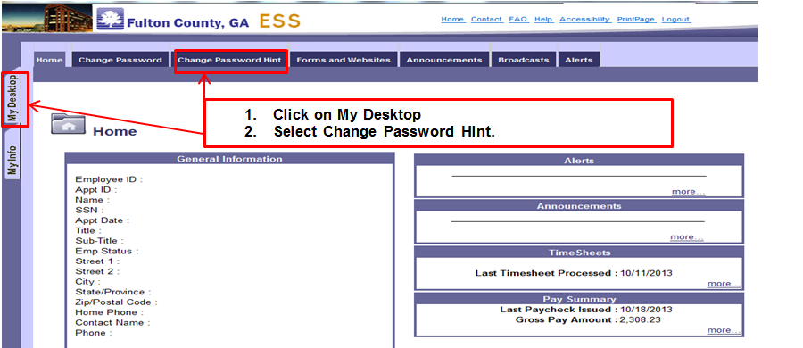
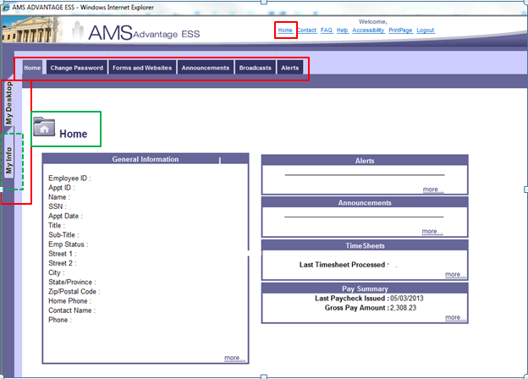
INITIAL LOGIN: ESS HOME PAGE
You will be brought to the Home Page. The Home Page displays General Information, Announcements, Alerts and Pay Summary.

Slide 19
PASSWORD HINT
You will need to create a Password Hint for your profile.

Slide 20
SECURITY
ESS is a secured online portal, similar to IRS E-File Systems & Online Banking.
All information contained in ESS is intended for the sole use of the individual employee.
Employees can access ESS at work, but are encouraged to print information from offsite printers to save Fulton County resources.

Slide 21
SECURITY, cont’d
Only you have access to your personal information. Timekeepers, Managers and Supervisors are not allowed to access your ESS profile.
Contact the I.T. Helpdesk (404-612-7334/ Technical.Support@fultoncountyga.gov) IMMEDIATELY if you suspect your login credentials have been compromised.

Slide 22
WELLS FARGO
Notes:
Congratulations
You are eligible for the Wells Fargo At Work program—a valuable package of accounts, services and special benefits
that can help you reach your financial goals.
Wells Fargo Premium Membership® Checking Package gives you more ways to access and manage your money
Take advantage of benefits on financial accounts and services
• home mortgages • home equity loans • personal loans • auto loans • student loans • investments*
• lines of credit • identity theft protection* • and more
Enrolling is easy:
1. Open a Premium Membership Checking Package at any Wells Fargo banking location
2. Sign up for Direct Deposit or set up another qualifying service to waive your monthly fee
3. Take advantage of all your Wells Fargo At Work benefits
To find out more, call 1−800−TO−WELLS (1−800−869−3557) stop by any Wells Fargo banking
location

Slide 23
QUESTIONS
EMAIL payrollunit@fultoncountyga.gov
Call 404-612-7605 Option 3
Notes:
If you have any questions regarding Payroll, please email Payroll Unit at payrollunit@fultoncountyga.gov or call 404-612-7605 Option 3.

Slide 24
THANK YOU!!!
Notes:
Thank you, and welcome to Fulton County.

