Slide 1


Whistleblower Hotline
Office of the County Auditor

Slide 2
Whistleblower act
O.C.G.A §45-1-4, the Georgia Whistleblower Act (“the Act”), was enacted in 1993 for the purpose of eliminating fraud, waste, and abuse in state programs and was designed to protect those persons making complaints or disclosures from reprisals.

Slide 3
OBJECTIVE
The objective of the whistleblower hotline is to provide Fulton County employees with a confidential reporting system that will be available 24 hours a day, 365 days of the year to report potential complaints of fraud, waste and abuse.

Slide 4


What SHOULD BE Reported ?
Fraud, Waste, and Abuse
Improper use of funds
Thefts of cash or Fulton County property
Falsification of documents
Conflicts of Interest
Kickbacks or bribes
Misuse of Fulton County time or resources

Slide 5
Definitions
“Fraud” is any intentional act or omission designed to deceive others that results in Fulton County suffering a loss of money, property or other disadvantage to the County’s resources or rights and/or the perpetrator achieves a gain of money, property or an advantage to which the employee would not normally be entitled.
“Waste” is the intentional or unintentional thoughtless, reckless or careless expenditure, consumption, mismanagement, use, or squandering of County resources. Waste also includes incurring unnecessary costs because of inefficient or ineffective practices, systems, or controls.
“Abuse” is intentional destruction, diversion, manipulation, misapplication, maltreatment, or misuse of County financial resources. Abuse can occur when someone benefits in a financial manner and also when someone does not benefit financially.

Slide 6
Why should you report?
Safeguards Fulton County assets
Promotes an ethical environment
Allows for complete dedication to the organization’s mission and success
Notes:
Prohibits management from retaliation as a result of whistleblower activities
Anonymous reporting

Slide 7



How to Report ?
Option 1: Call 1- 844-784-7401
(24 hours a day - 7 days a week - 365 days a year)
Option 2:
Option 3: Employee Central

Slide 9
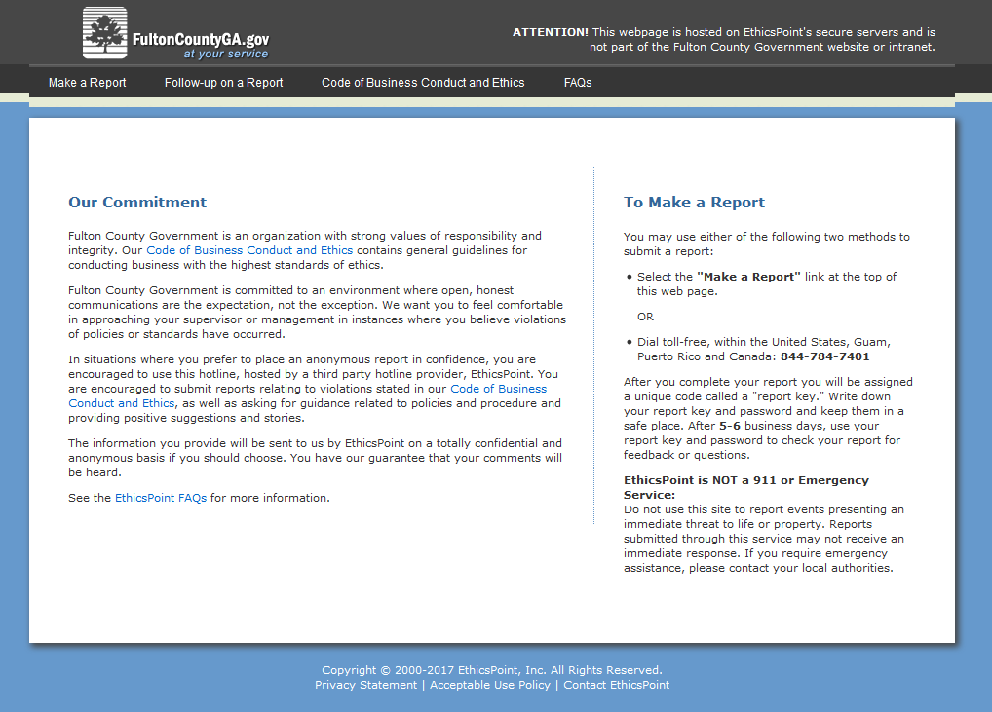


Slide 10
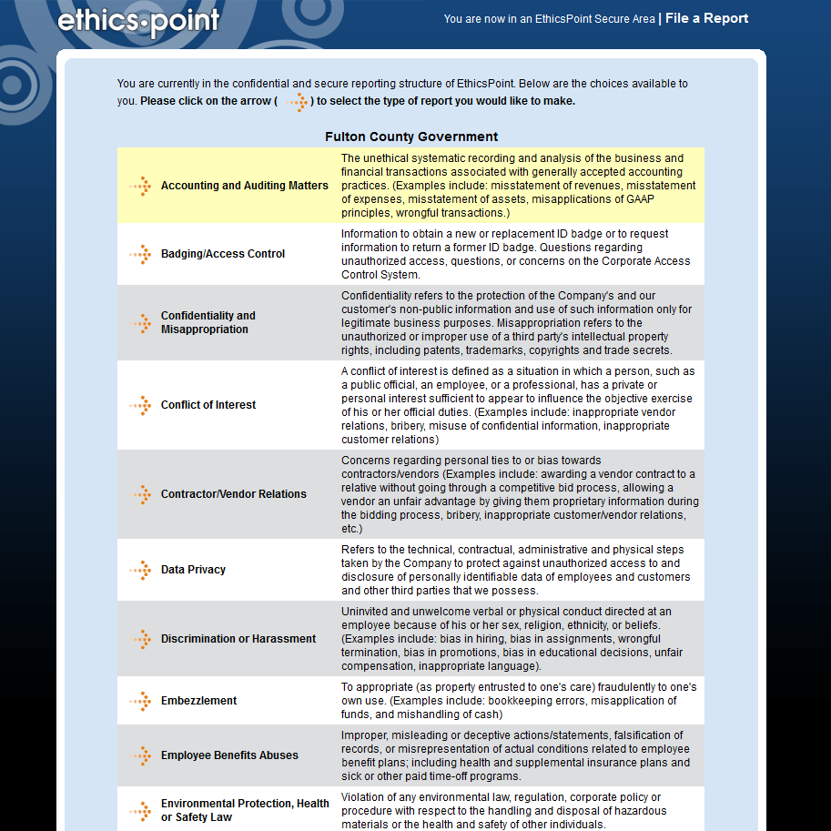
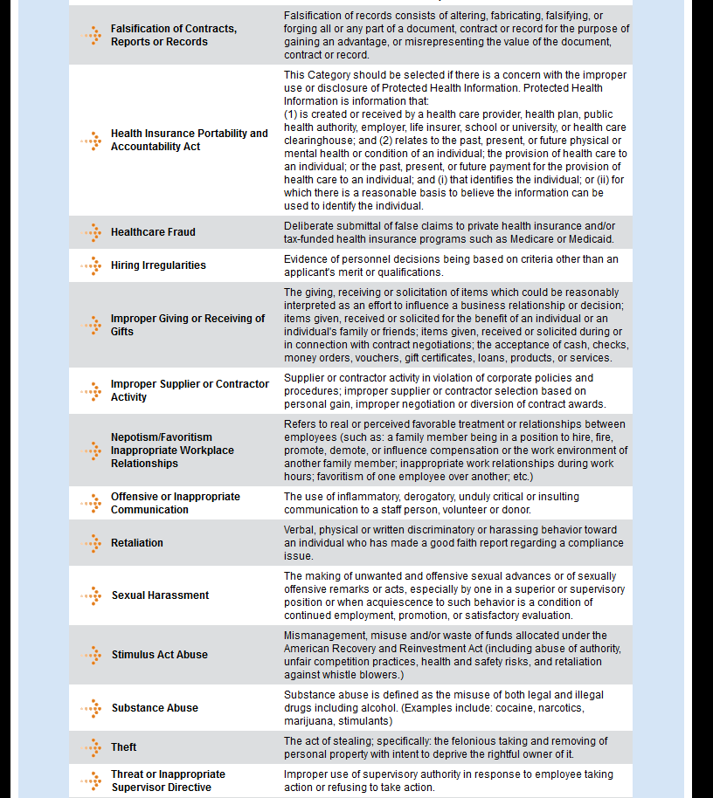
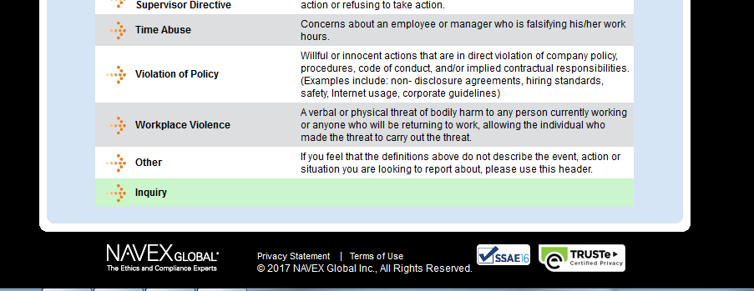

Slide 11
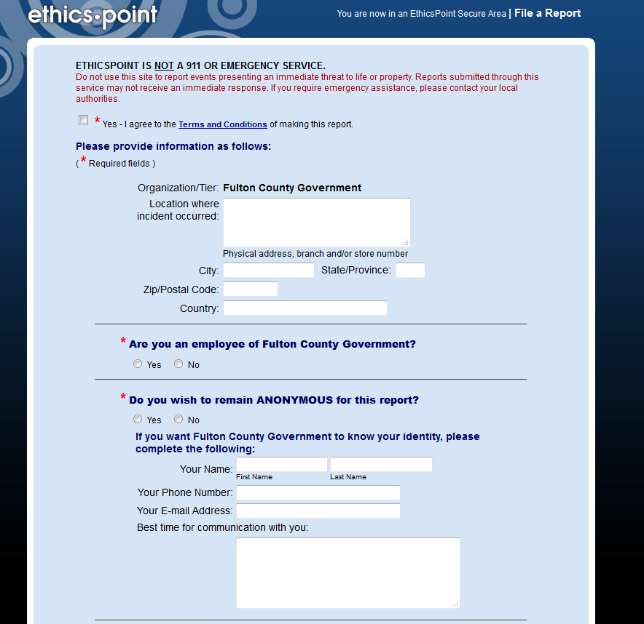
Notes:
The Whistleblower Hotline is specifically for EMPLOYEES ONLY
Through Hotline and Website you have the option to report anonymously.

Slide 12
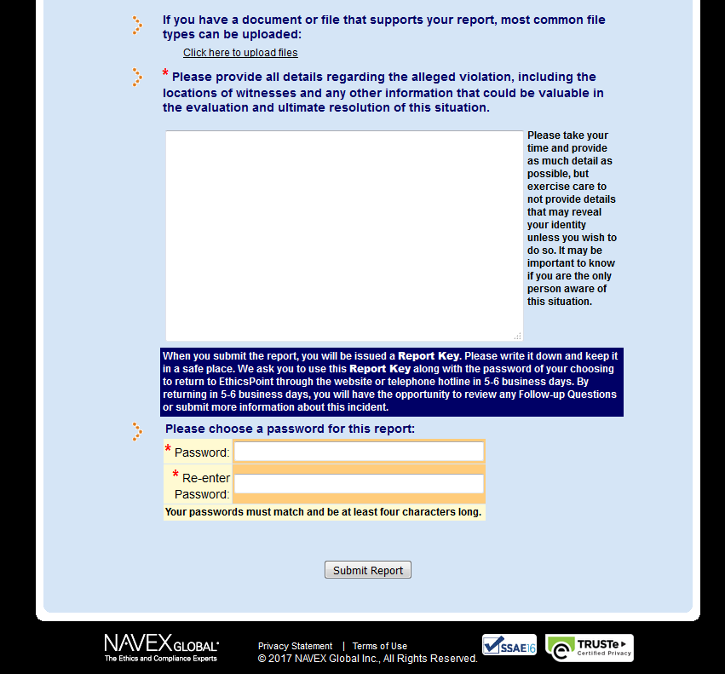
Notes:
Please remember your REPORT KEY and PASSWORD. Will need the Report Key to access your report and check follow-up questions or comments we may ask for.
Once the report is submitted, response within 24 hours or the NEXT business day to review the case.

Slide 13


Slide 14
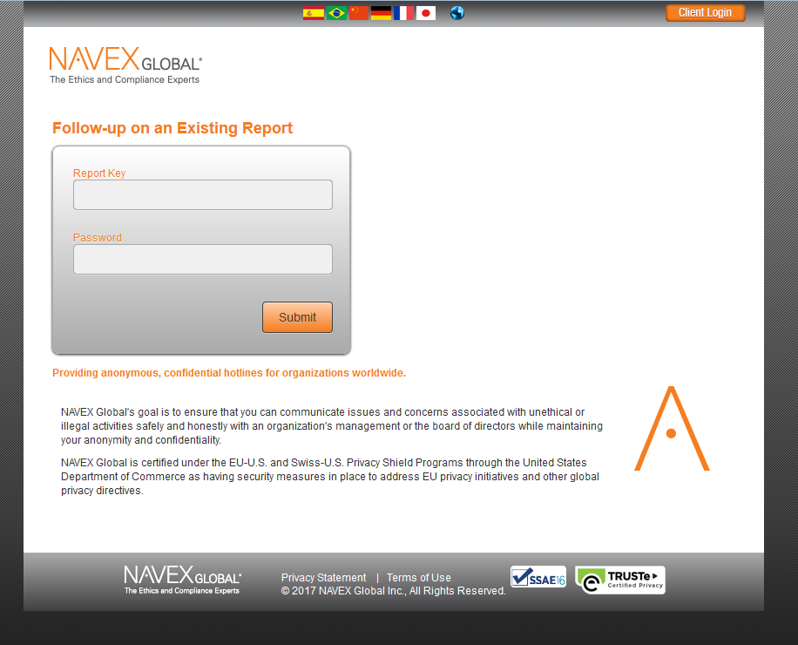

Slide 15

Questions

Slide 16
Welcome To
Fulton County Government!!!

