Slide 1

Welcome to Fulton County

Slide 2

Library Website - www.fulcolibrary.org

Slide 3
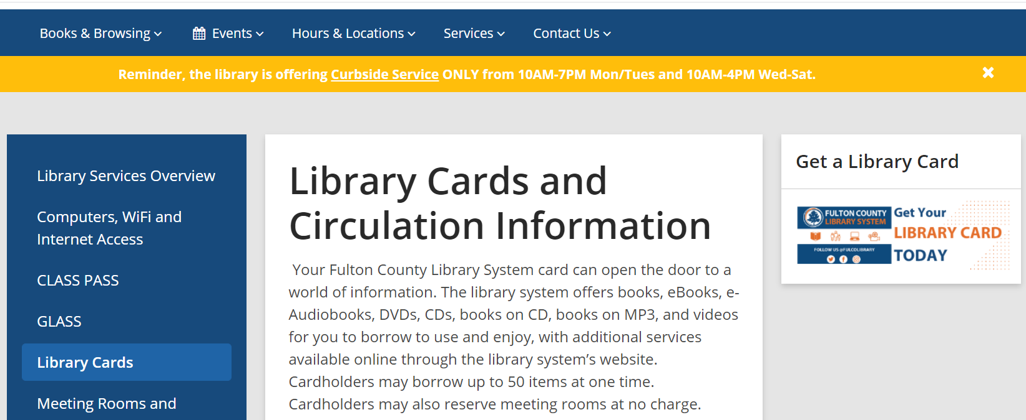
Click Services then Library Cards

Slide 4
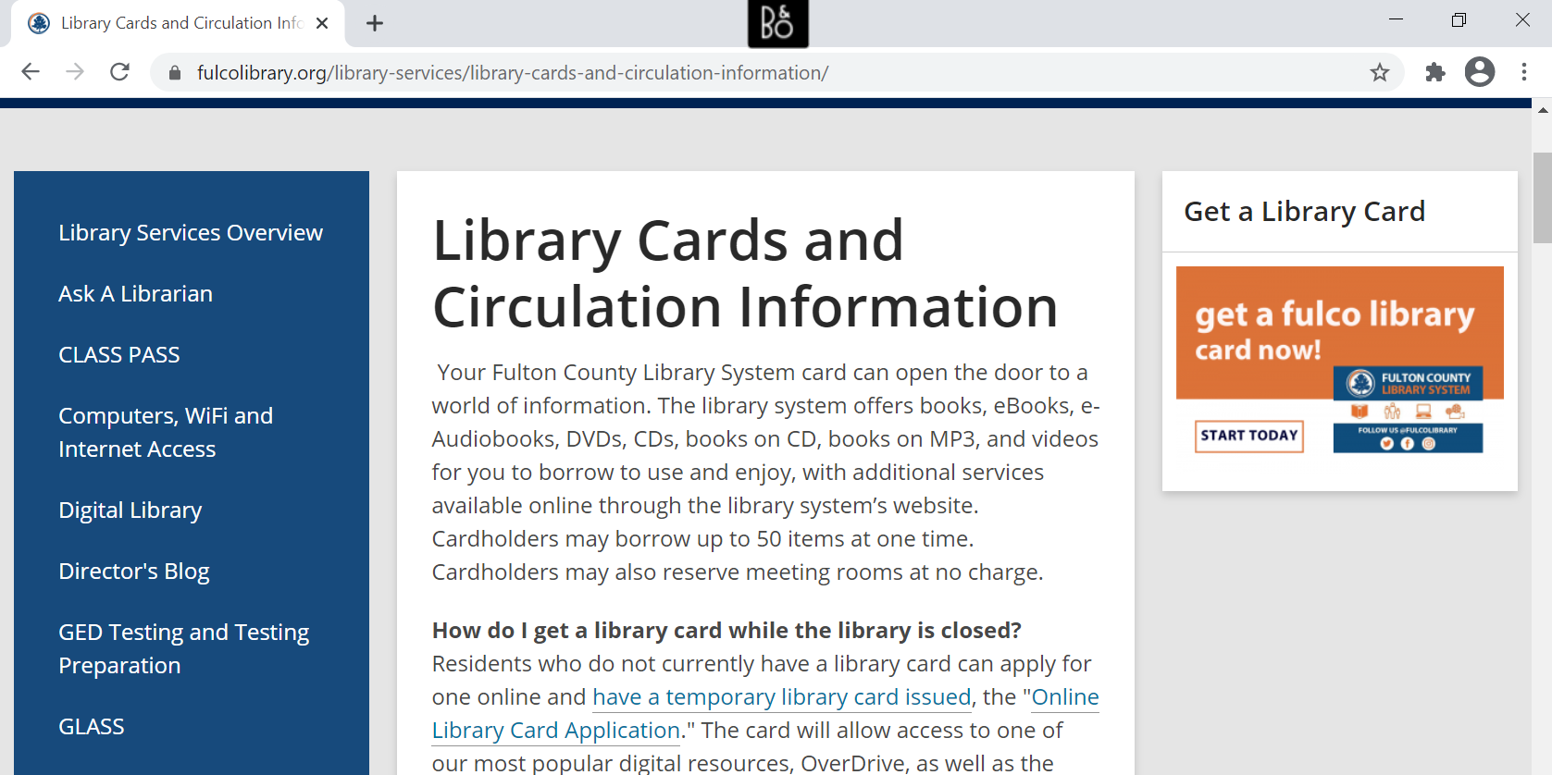


Slide 5
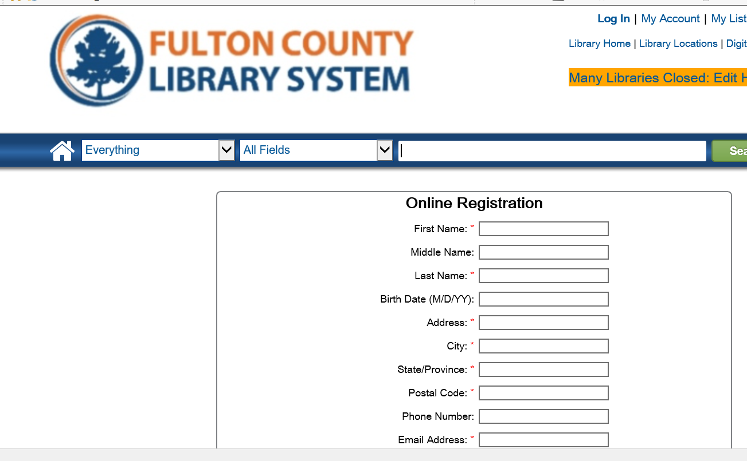
Click Online Library Card Application

Slide 6
All County Employees Receive a Library Card
Complete the library card application
You will receive an email with your new card number
Library card # is D+9 numbers (no space)
Your temporary card is good for 30 days
Visit the branch to obtain your permanent card
Card is valid for 2 years
Access to all library resources

Slide 7
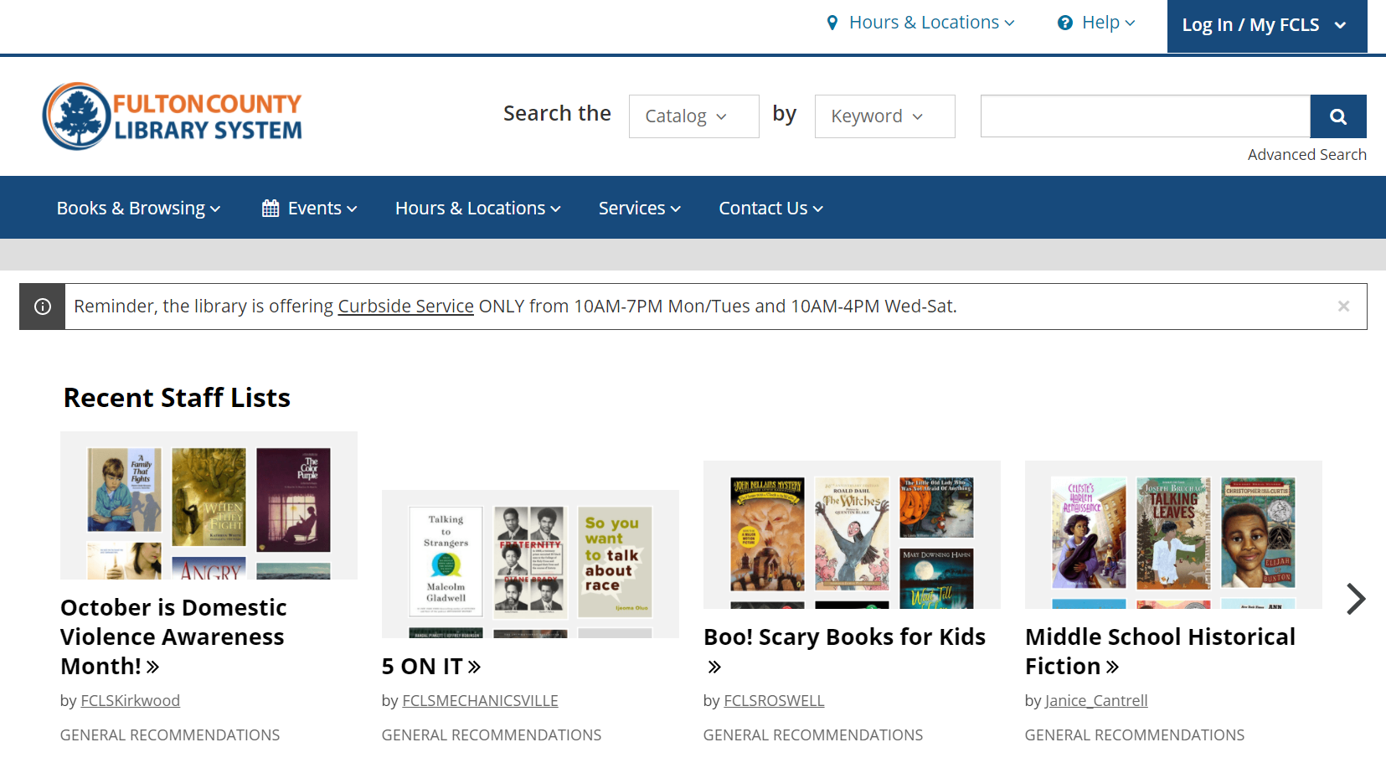
Search the Catalog or Click Books & Browsing

Slide 8
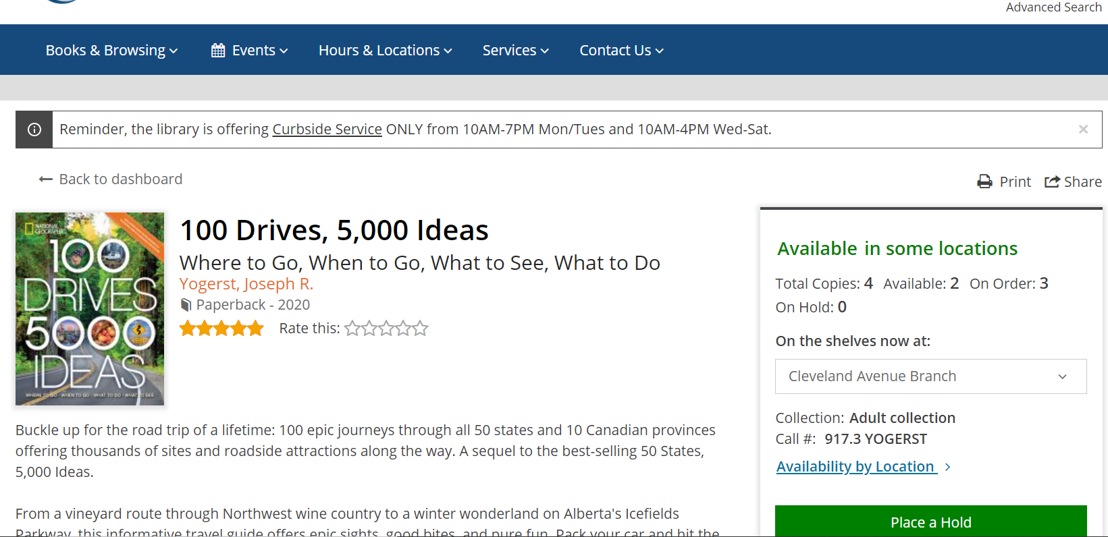
Place a Hold

Slide 9


Library Hours
Monday, Tuesday
10-8
Wednesday - Saturday
10-6

Slide 10
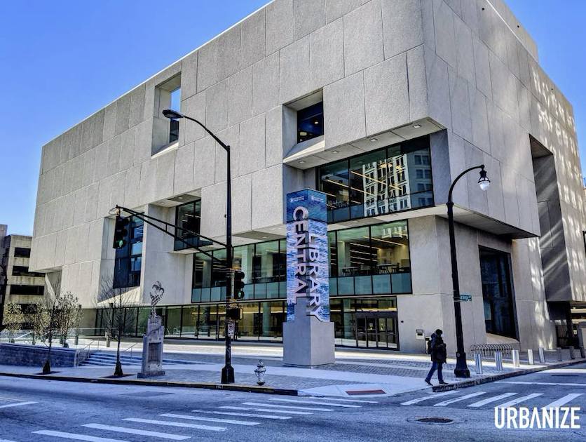
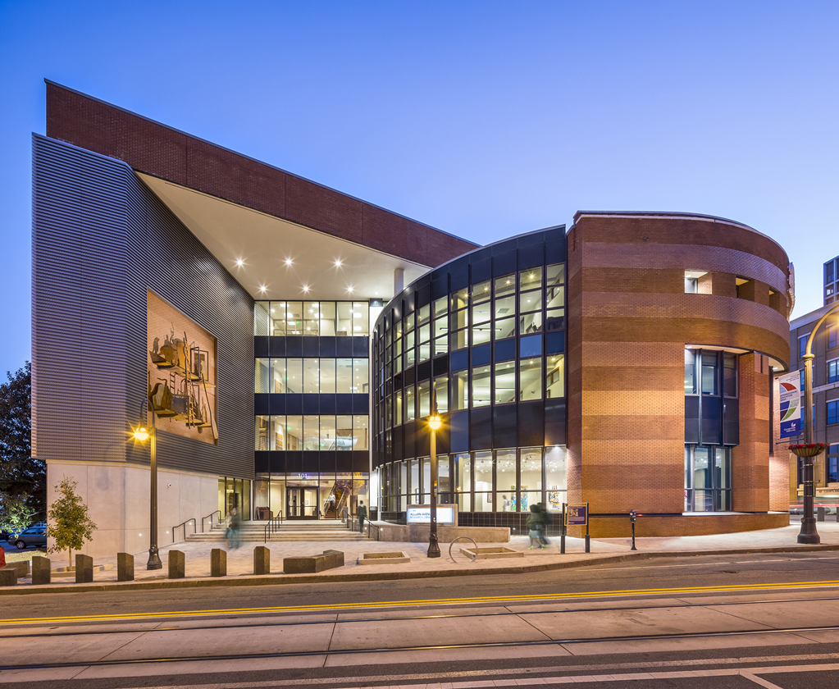
34 Library Locations in Fulton County
Central Library
Auburn Avenue Library on African American Culture and History

Slide 11
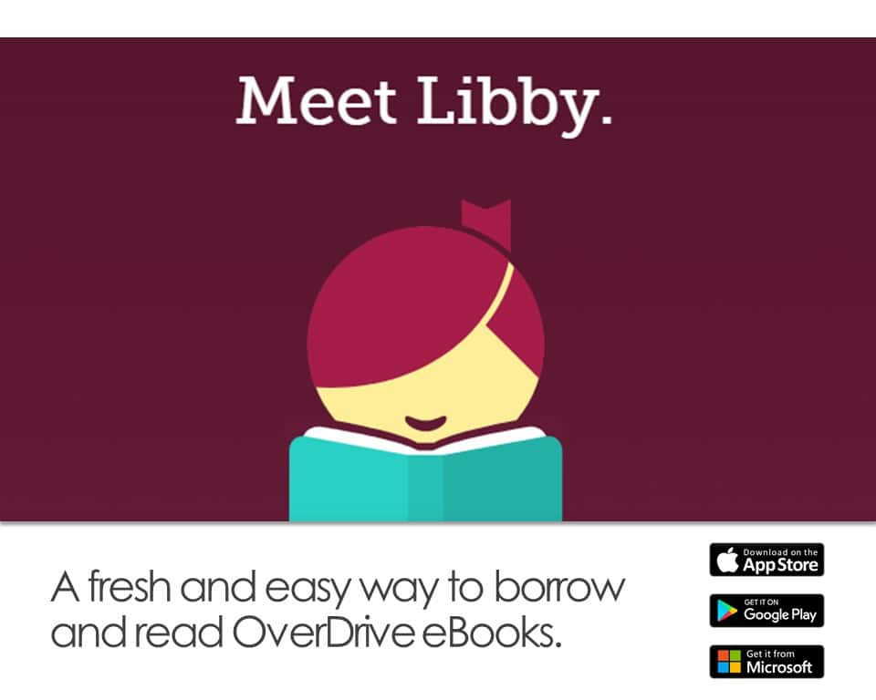


Enjoy our Online eResources
Library Website - fulcolibrary.org
OverDrive
Check out the latest bestseller eBooks and Audiobooks for 7, 14 or 21 days with no late fees.
Hoopla - Borrow 10 items a month.
Instantly borrow free digital eBooks, audiobooks, movies, music, comics, and TV shows. Choose from over 800,000 titles.

Slide 12

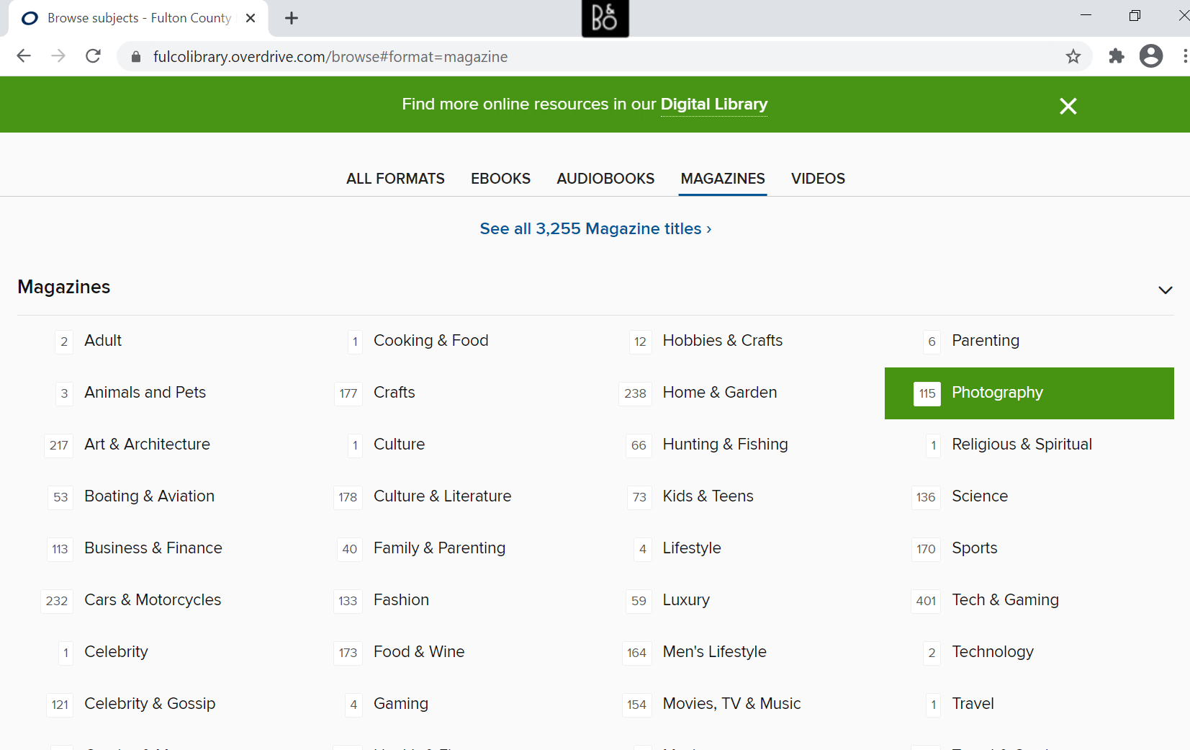

Enjoy Free Magazines and Music
Check out digital magazines in OverDrive
Download or stream music

Slide 13
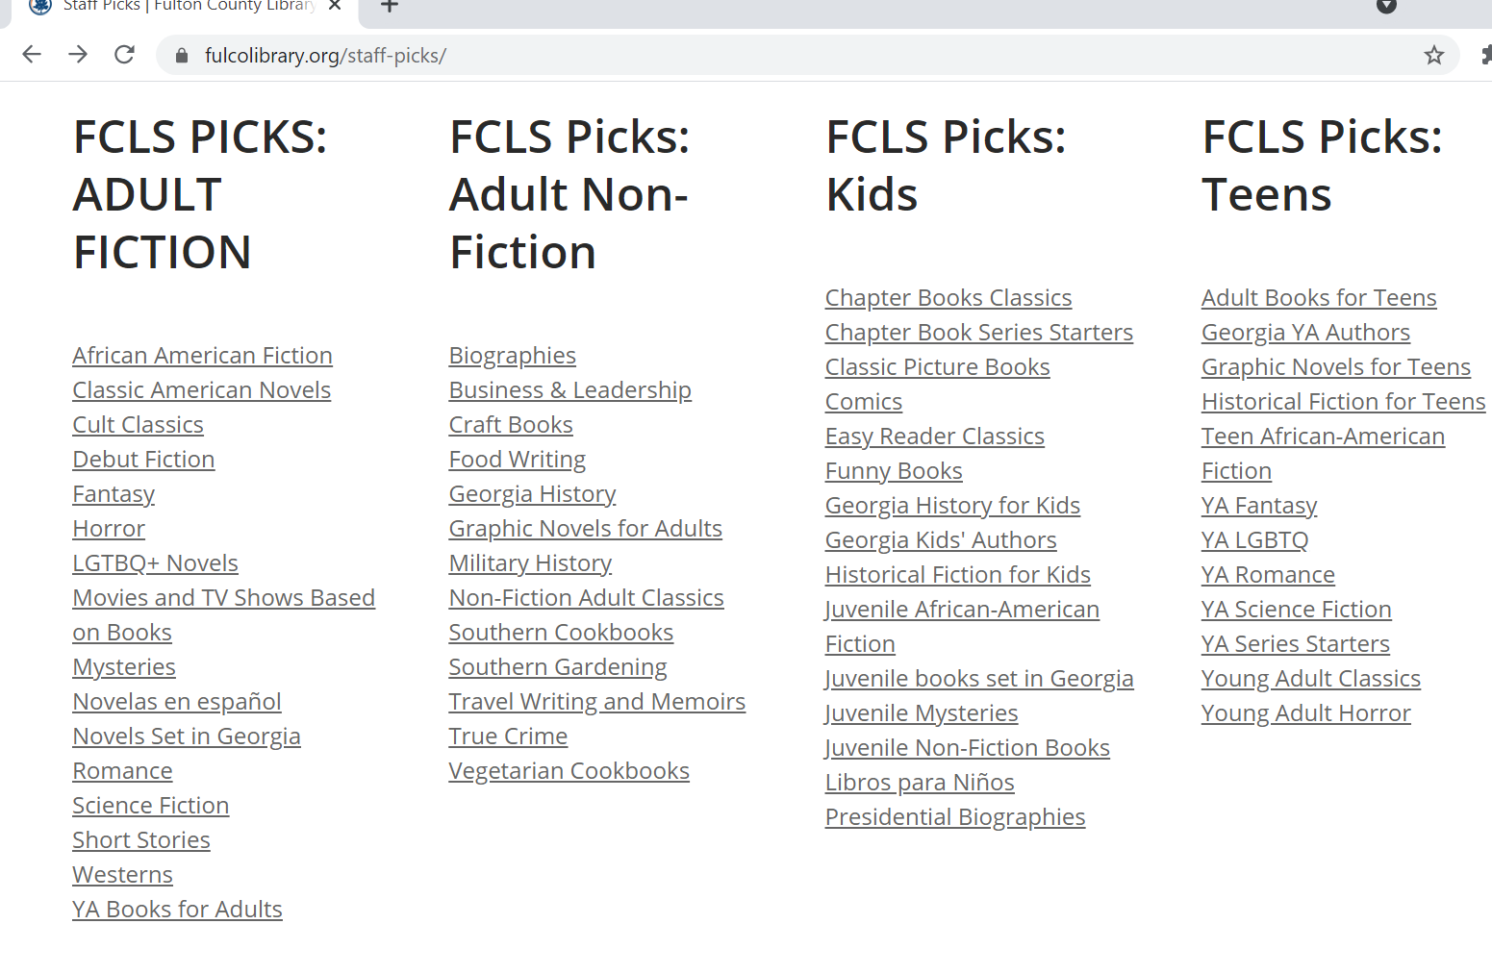
Staff
Picks
Find your
next
great read!
Join our Online Book Club!

Slide 14
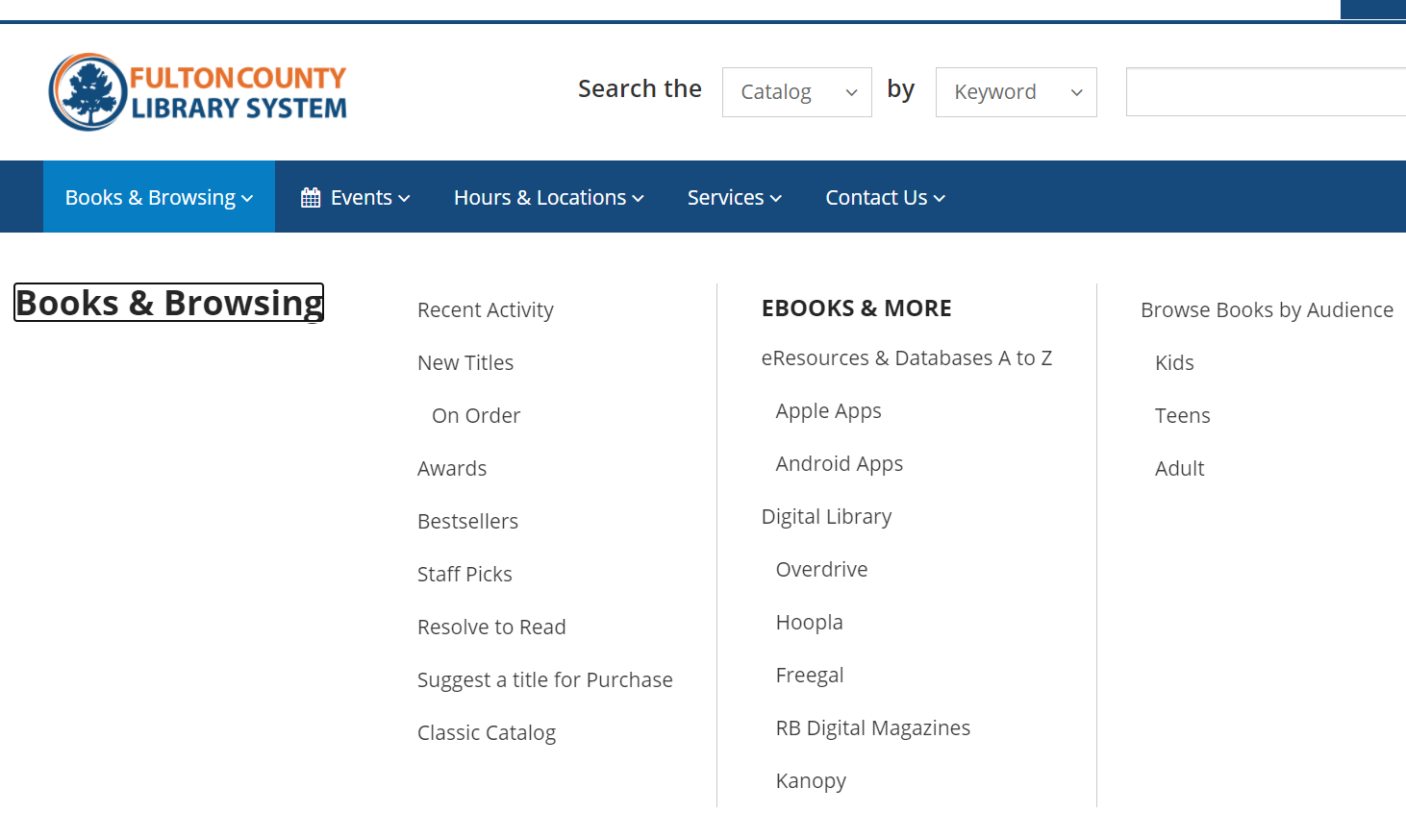

Visit our
Digital Library

Slide 15
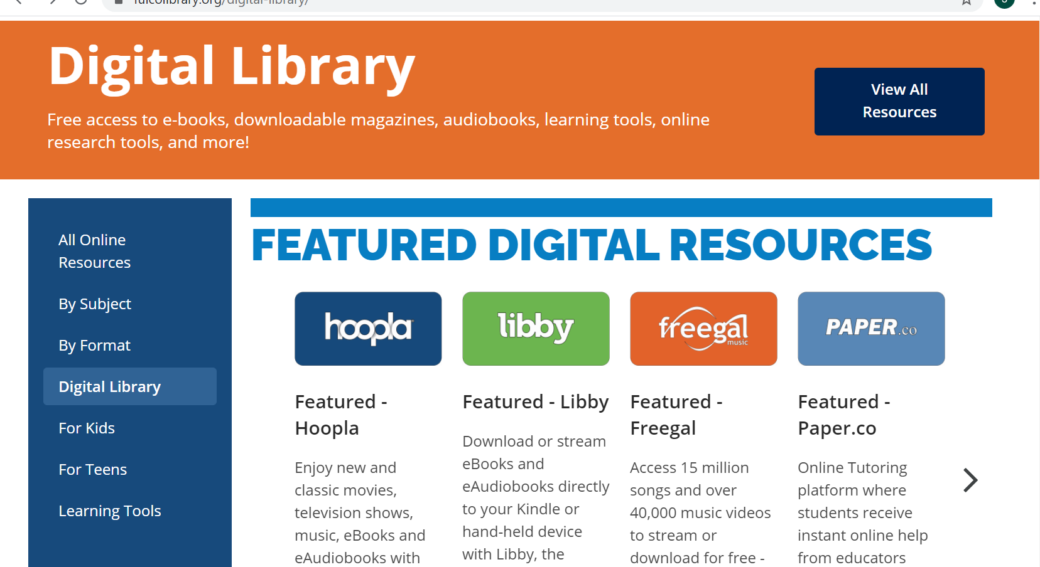

Slide 16


Click Learning Tools
Mango Languages - Prepares learners for realistic conversations and communication in over 70 languages.
Peterson’s Test Prep - Testing guides, full-length practice tests, and tools for scholarship research.

Slide 17
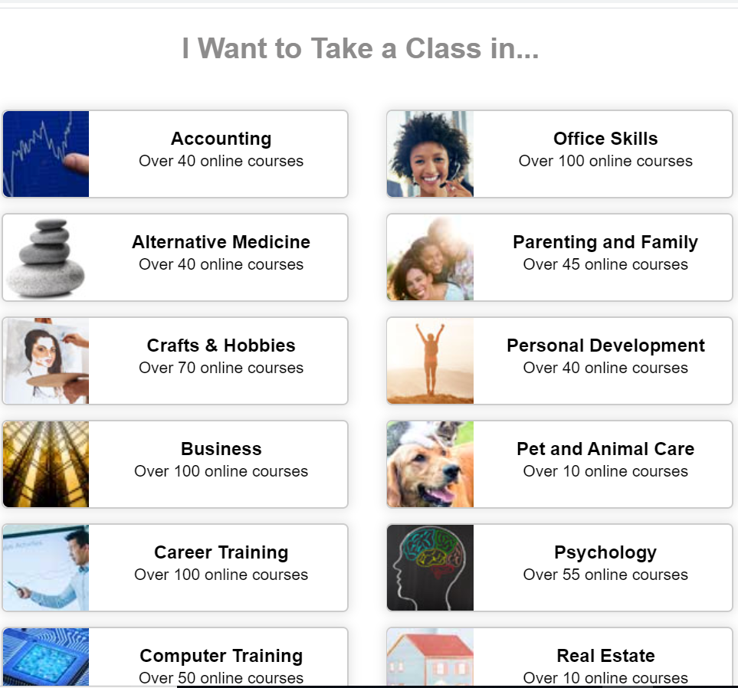


Over 500 online self-paced continuing education classes in a range of subjects related to skills, jobs or personal growth. Certificate of completion provided.

Slide 18
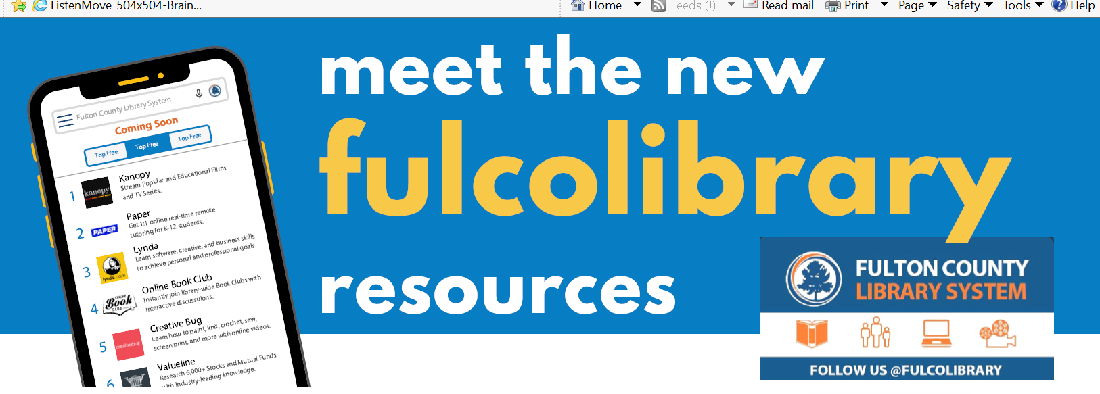

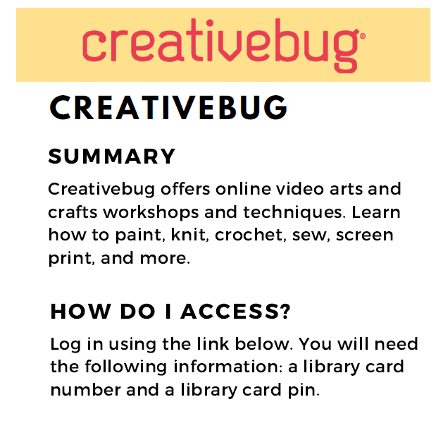
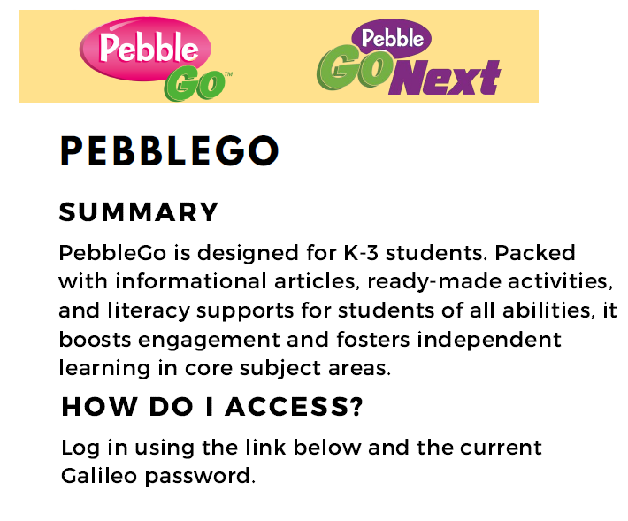

Slide 19
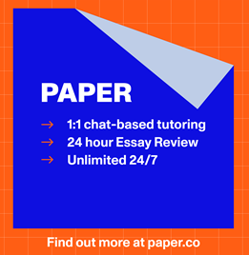

FREE ONLINE TUTORING
Paper - Live help. Students receive instant live
help from educators.
Essay feedback. Written work is reviewed and
annotated by an educator to give students
rapid writing feedback.
Tutor.com - Get a tutor 24/7 in 40+ subjects
including Math, Science and English. K-12,
college and adult learners.

Slide 20
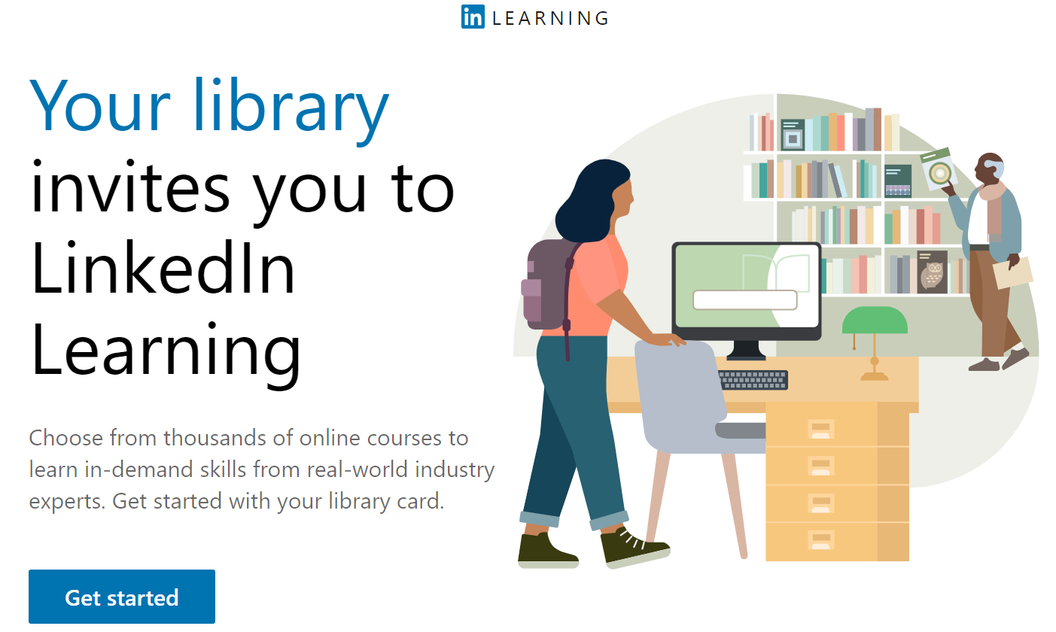
LinkedIn Learning
Enter through library website

Slide 21


Slide 22
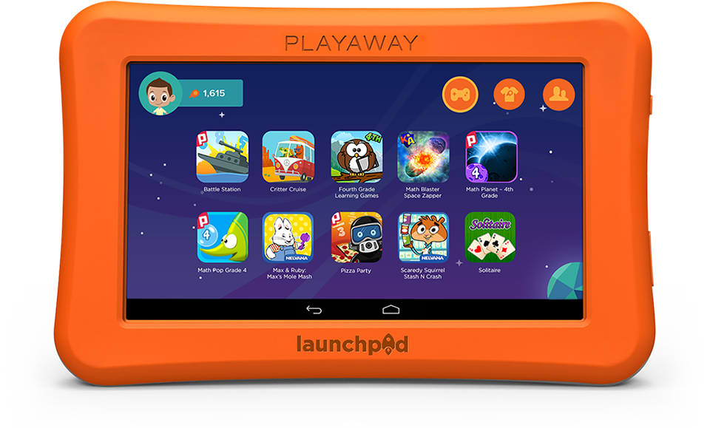


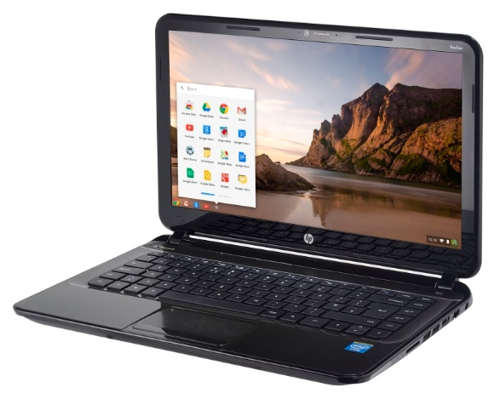


Available to all card holders

Slide 23








Free Attraction Passes

Slide 24

Questions?
Email me at joy.burson@fultoncountyga.gov
www.fulcolibrary.org

