Slide 1


Fulton County
2024 Active
Open Enrollment

Slide 2
What will we cover today?
2024 Open Enrollment Updates
Open Enrollment
Tobacco-Use Attestation and Wellness Credit
2024 Benefit Information
  Medical Plans
  Dental Plans
  Vision Plan
  Life, AD&D and Disability Insurance
  Voluntary Benefits
Next Steps

Slide 3
Important for 2024
Benefit Updates
No benefit changes for 2024
Anthem premiums for the HSA, HMO and POS plans are increasing by 1.7%
Tobacco Attestation and
Wellness Credit
Kaiser HMO Plan premiums are increasing by 6%
If you enroll in medical coverage for 2024, you must complete
the Tobacco-Use Attestation
by October 13. If you do not complete the attestation online, you will pay a $25 biweekly tobacco-use surcharge starting January 1, 2024
No changes to Basic Life and AD&D, Supplemental Life or Dependent Life premiums
Aetna Dental PPO Plan premiums are increasing by 2.7%
Wellness Credit for 2024 – You can still reduce your 2024 premium under any of the medical plans by $20 each month ($240 per year). Complete your biometric screening by December 31, 2023, to earn/keep your $240 wellness credit. There will be no COVID-19 vaccination requirement to earn the wellness credit
Aetna Dental HMO Plan Premiums increasing by 4%
EyeMed Vision PPO Plan decreasing by 7.5%
Anthem HSA employee-only coverage in-network deductible increasing to $1,800 and out-of-pocket maximum increasing to $3,600
Anthem HSA family coverage in-network deductible increasing to $3,600 and out-of-pocket maximum increasing to $7,200
If you are a tobacco user, you must complete a tobacco cessation program by May 31, 2024, to receive a refund of the surcharge. You will receive details about the tobacco cessation program in the first quarter of 2024.
Open Enrollment: September 25 – October 13, 2023

Slide 4
Open Enrollment
If you want medical, dental and vision coverage that is effective January 1, 2024, you must enroll online through Employee Self Service (ESS).
All employees enrolled in a medical plan must complete the Tobacco-Use Attestation online in ESS by October 13, 2023.
If you don’t enroll by October 13, 2023, you and your current dependents will be defaulted to medical coverage in the Kaiser HMO Plan for 2024 with no coverage for dental and vision.
  If you currently waive medical coverage but are enrolled in the dental and vision plans, you will need to enroll through ESS to keep these plans.
  If you currently waive medical, dental and vision coverage, you will continue to have no coverage in 2024 if you do not complete enrollment by October 13, 2023.
2024 Open Enrollment:
September 25 – October 13, 2023

Slide 5
Employee Self Service (ESS) Enrollment
Online enrollment through ESS is required.
You must know your 10-digit Employee ID number to access ESS.
  You can also request your Employee ID number from your Department HR Liaison.
  For assistance with password reset, contact the Information Technology Department Help Desk at 404-612-7334 or email technical.support@fultoncountyga.gov.
Log in to ESS today!
bit.ly/34mcmev

Slide 6
Medical Plans
Anthem H.S.A
Anthem POS
Anthem HMO
Kaiser HMO

Slide 7

How the Anthem HSA Plan Works
Start here!
No charge to you for in-network preventive care
Your Annual Deductible Responsibility
Annual Out-of-Pocket Maximum
  You pay 100% of first-dollar charges up to annual deductible. Use HSA money to cover these expenses.
  Once you meet the deductible, you pay 10% of the cost
  for most covered
  in-network services. Use HSA money to cover these expenses.
  Fulton County HSA contribution:
    Single: $750
    Family: $1,500
  Optional employee HSA contribution
  Plan pays 100% of covered charges after you reach the annual out-of-pocket maximum.
HSA Contributions
Coinsurance
Use Anthem’s online Care and Cost Finder tool
to model your potential costs

Slide 8
How the HSA Works
You contribute tax-free to the HSA, up to $3,400 (single) or $6,800 (family) each year. The County will contribute $750 (single) or $1,500 (family) to the account too.
Use the money on your HSA debit card to pay deductibles, copays and coinsurance for medical, prescription drug, dental, vision and hearing expenses.
After HSA money runs out, you will have to pay the cost out of pocket until you meet the annual deductible.
Money left in your HSA at year-end can be carried over to the next year. If you leave County employment or change health plans, remaining HSA money can be taken with you.
  The HSA is in your name and it’s your account.
HSA money can be used for qualified medical expenses until money runs out.
If you do not elect a qualified high-deductible health plan for 2023 or you move to Medicare, you can still use your HSA money to pay for copays and qualified medical expenses. However, you won’t be able to make contributions to your HSA, and the County will no longer make contributions to your HSA.

Slide 9
How the Anthem POS Plan Works
Start here!
No charge to you for in-network preventive care
Your Annual Deductible Responsibility
Annual Out-of-Pocket Maximum
  Choose between in-and out-of-network providers each time you need care.
  If you go in-network, you pay copays (e.g., doctor’s office visit, urgent care visit). Copays are separate from, and don’t count toward, the annual deductible.
  Some services are covered through coinsurance after you meet the annual deductible (e.g., outpatient treatment and hospital services).
  Once you meet the annual deductible, you pay 20% of
  the cost for most
  in-network services until you reach the annual out-of-pocket maximum.
  The plan pays 100% of covered charges once you reach the annual out-of-pocket maximum.
  Your copays, deductible and coinsurance are included in the out-of-pocket maximum.
Pay Your Copays
Coinsurance

Slide 10
How the Anthem HMO Plan Works
Start here!
No charge to you for in-network preventive care. No PCP referrals needed!
Pay Your Copays
  You pay applicable copays for services (e.g., doctor’s office visit, urgent care visit, hospital visit). Plan pays 100% of covered charges after the applicable copay.
  Plan pays 100% of covered charges once you reach the annual out-of-pocket maximum.
  Be sure to see providers who participate in the Anthem HMO network; otherwise, no benefits are paid except for emergencies.
See Anthem Providers
Annual Out-of-Pocket Maximum

Slide 11
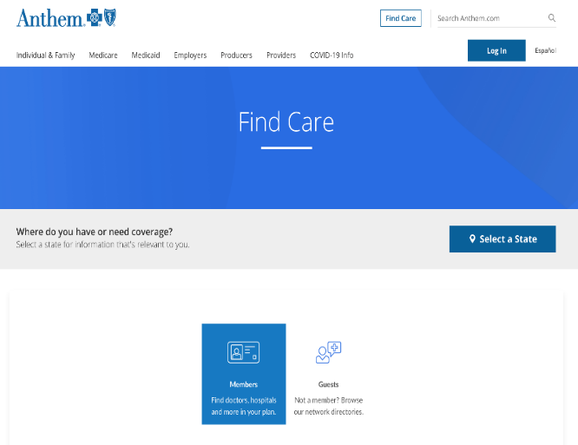
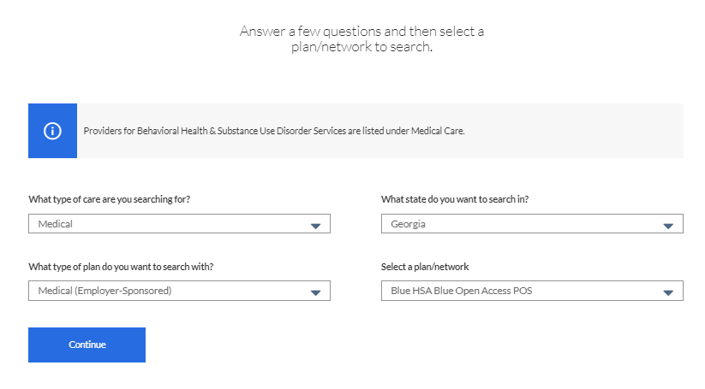
How to Locate an Anthem Network Doctor
Go to anthem.com/find-care
To search as a member: Use your member ID card number or log in with a username and password
  Once you’re logged in, the search will automatically include doctors and other providers in your plan
  Enter the search categories based on what you need and click Search
To search as a guest: Select Guests
  Select the best answers from each drop-down menu
  Select a plan/network (Blue Open Access HMO, Blue Open Access POS, or Blue HSA Open Access POS) and click Continue
  Select the best answers for the next set of fields and click Search

Slide 12
Benefits of Using Grady Health Care
Anthem and health care provider Grady Health System together offer you access
to high-quality health services at no cost to you.*
  Inpatient services, including hospitalizations and inpatient testing
  Outpatient services, including doctor visits and outpatient treatment
  Neighborhood health centers for visits to Grady’s neighborhood clinics
Grady is one of the largest public hospital systems in the Southeast and is a
world-renowned teaching hospital.
  Staffed with doctors from Emory University and Morehouse Schools of Medicine—two of the most prestigious medical teaching institutions in the U.S.
*If you enroll in the Anthem HSA Plan and use Grady Health System providers, services will be covered at 100% after you meet the deductible.

Slide 13



Find your healthy place
With care designed to help you thrive
2024 Annual Enrollment

Slide 14

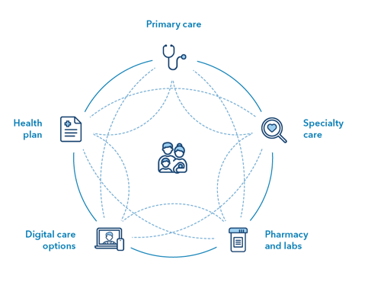
Finding your healthy place with connected care
Primary care
We combine care and coverage:
Doctors
Hospitals
Health plan
Care feels easier and is centered around you.
Health
plan
Specialty
care
Digital care
options
Pharmacy
and labs
14 | Copyright © 2020 Kaiser Foundation Health Plan, Inc.

Slide 15
Experience the many ways to get care

Slide 16

Care the way you want it
Phone
Save an office visit by scheduling a call with a doctor.¹
In Person
Same-day appointments are often available.
Chat with a Doctor
Connect in real time, online with a Kaiser Permanente physician.
MEMBER
Video Visit
Online alternative to an
in-person appointment.^{1,2}
Email
Message your doctor’s
office with nonurgent
questions, anytime.¹
kp.org/getcare
E-Visit
Online consultations are
available for some
medical conditions.
¹ These features are available when you receive care at Kaiser Permanente medical offices.
² Check with your doctor’s office to find out if video visits are available to you.

Slide 17
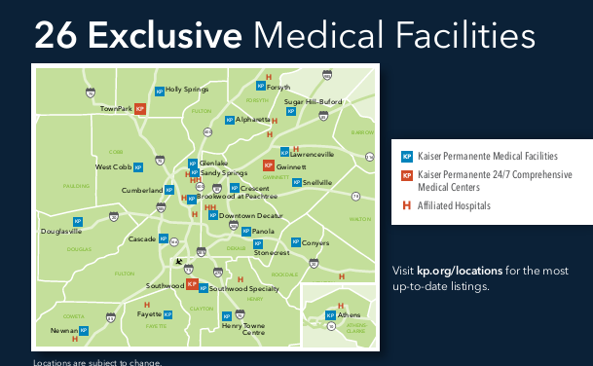
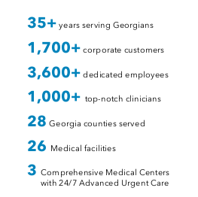
Conveniently located throughout metro Atlanta
kp.org/doctorsandlocations

Slide 18
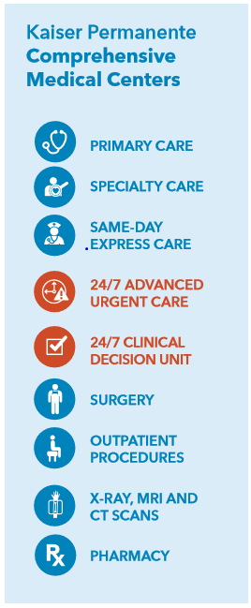


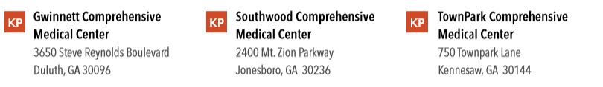
Comprehensive Medical Centers
Care That’s Close By
18

Slide 19





Hospital Partners

Slide 20
The Kaiser Permanente plan

Slide 21
The Kaiser Permanente Plan
This table shows an example of some of your benefits.
Annual deductible | $0 individual / $0 family
Annual out-of-pocket max | $6,450 individual / $12,900 family
Covered service | You pay
Primary Care | $25 co-pay
Specialty Care | $40 co-pay
Outpatient surgery | $150 co-pay
Urgent Care | $50 co-pay
Emergency department visit (co-pay waived if admitted) | $150 co-pay
Ambulance services (per trip) | 100% covered
*This is a summary of some benefits and their co-pays. For specific information about your covered health plan benefits, limitations, and exclusions, including those not listed in this summary, please see your Summary Plan Description.
Notes:
Now let’s take a look at some key benefit and associated co-pays. Your annual deductible is $0 for you and your family. Your Annual out of pocket maximum is $3000 for an individual and $6,000 for a family, meaning those are the maximum dollar amounts you or your family would be responsible for paying out of pocket in a plan year. A few other key benefits to call out…… (read out benefits & co-pays). Again, all benefits on the Kaiser Permanente plan are based on co-pays only.

Slide 22
The Kaiser Permanente Plan
This table shows an example of some of your benefits.
Covered service | You pay
X-rays and lab tests | $0 copay
Routine preventive physical exams | $0 copay
Well-child preventative care visits (0-24 months) | $0 copay
Scheduled prenatal care visits and first postpartum visit | $0 copay
*This is a summary of some benefits and their copays. For specific information about your covered health plan benefits, limitations, and exclusions, including those not listed in this summary, please see your Summary Plan Description.
Notes:
We’d also like to point out a number of benefits available to you at $0 copay….. (read out covered services)

Slide 23
The Kaiser Permanente Plan
This table shows an example of some of your benefits.
Covered service | You pay
Prescription drug coverage (up to a 30-day supply) | Tier 1 - $10 copay (generic) Tier 2 - $30 copay (preferred brand) Tier 3 - $50 copay (non-preferred brand) Tier 4 - $75 copay (specialty)
Mail Order drug coverage (up to 90-day supply) | Tier 1 - $20 copay (generic) Tier 2 - $60 copay (preferred brand) Tier 3 - $100 copay (non-preferred brand) Tier 4 - $150 copay (specialty)
Note: To see where your current medications fall within our formulary, visit kp.org/formulary and choose “2024 Five-Tier formulary plan”. If the cost to receive your medication has increased, Kaiser Permanente pharmacy consultants are available to help you find a lower cost alternative.
*This is a summary of some benefits and their copays. For specific information about your covered health plan benefits, limitations, and exclusions, including those not listed in this summary, please see your Summary Plan Description.
Notes:
Now let’s take a look at your pharmacy copays. With the Kaiser Permanente plan, our formulary is broken out into 5 tiers. Tier 1 drugs are preventative generic, Tier 2 drugs are preferred generic, Tier 3 drugs are preferred brand, Tier 4 drugs are Non-preferred and Tier 5 drugs are specialty. With mail order, you can receive a 90 days supply sent to your home and you save a bit of money on a 3-month supply.

Slide 24
Care While Traveling

Slide 25

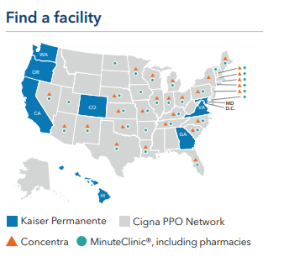


Care while traveling
If you get hurt or sick while traveling, you’re covered for emergency and urgent care anywhere in the world.
Get urgent care at a Cigna PPO Network*, MinuteClinic® or Concentra urgent care center when you’re traveling outside a Kaiser Permanente area.
We can also help you before you leave town by checking to see
if you need a vaccination, refilling eligible prescriptions, and more. Just call us or go online:
24/7 Away from Home Travel Line: 951-268-3900*
or kp.org/travel

Slide 26
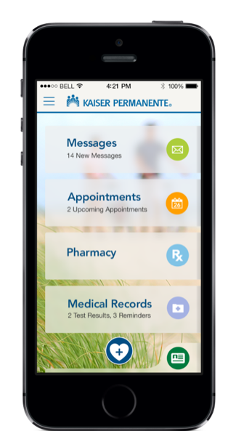
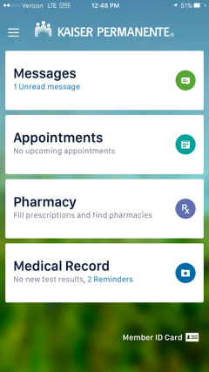
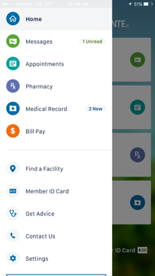

Digital Membership Card
The digital membership card is a replica of the physical membership card, available on your mobile phone via the Kaiser Permanente app
View you and your family’s membership card information
Check in for services at Kaiser Permanente facilities
Pick up prescriptions at a Kaiser Permanente pharmacy
Use as a valid form of identification (if photo is available in KP Health Connect System)
Digital membership card Icon on app dashboard

Slide 27
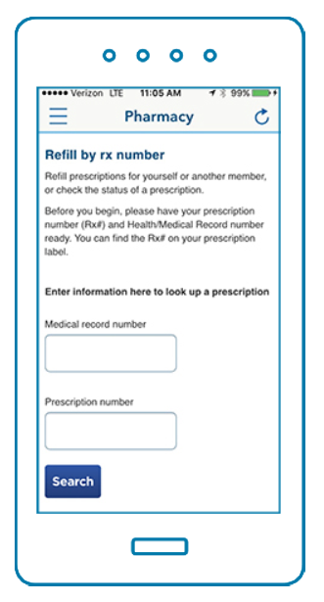
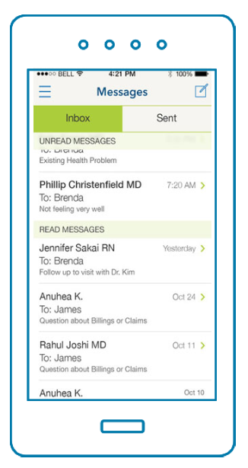
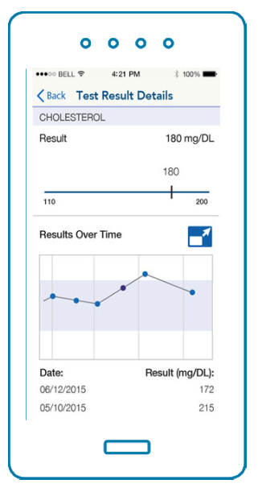
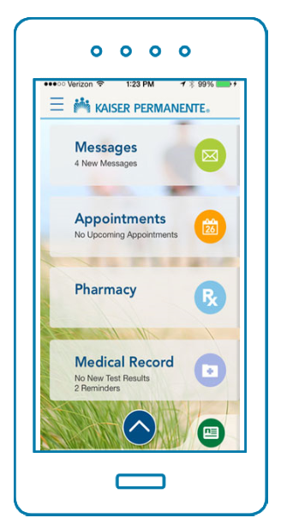
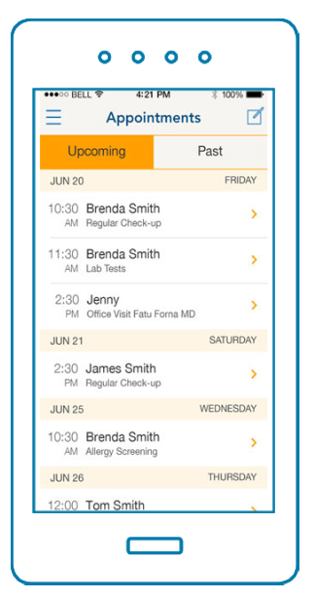
Kaiser Permanente mobile app
Manage & refill
prescriptions
Email your
doctor
View most
test results
Manage your care on the go
View & schedule appointments

Slide 28









ClassPass workouts
Get moving with fitness options that fit your schedule and lifestyle, including Pilates, dance, , cardio, and yoga.
Active & Fit Direct
Get discounts up to 55% or more on popular health and fitness brands
• Enroll in the Active&Fit Direct™ program and find a fitness center or exercise studio, stay active at home with digital workouts, and
more for as low as $25 a month*
myStrength
myStrength platform empowers individuals with personalized pathways incorporating multiple programs to help manage and overcome challenges.
Managing Depression
Controlling Anxiety
Reducing Stress
Improving Sleep
Learn more: kp.org/choosehealthy

Slide 29
Want to learn more?

Slide 30

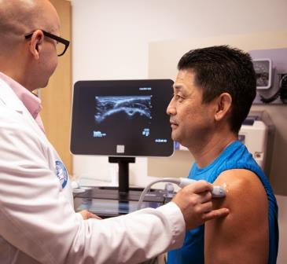

Want to learn more?
Choosing a health plan is a big decision — so we’re here to answer any of your questions.
Ask about the essentials
Where to get care
Specialty care services
Support for ongoing conditions
Or about our extra perks
Video visits* and other convenient ways
to access care
Apps, podcasts, and other self-care resources available to you at no cost
How our doctors, hospitals, and health plan work together to make your life easier
Call your Kaiser Permanente dedicated team at (404)760-3549
Monday through Friday, 7 a.m. to 7 p.m. EST
*When appropriate and available.

Slide 31

Thank you

Slide 32
Comparing Medical Plans
 |  | Anthem HSA |  | Anthem POS |  | Anthem HMO | Kaiser HMO
 |  | In- Network | Out-of-Network | In-Network | Out-of-Network | In-Network Only | In-Network Only
County-Provided HSA Contribution |  | Single: $750 EE +1 / Family: $1,500 |  | Not available |  | Not available | Not available
Annual Deductible | Single | $1,800 | $3,000 | $500 | $1,000 | No deductible | No deductible
 | EE + 1 | $3,600 | $6,000 | $750 | $1,500
 | Family | $3,600 | $6,000 | $1,000 | $2,000
Out-of-Pocket Maximum | Single | $3,600 | $6,000 | $2,000 | $4,000 | $6,450 | $6,450
 | EE + 1 | $7,200 | $12,000 | $3,000 | $6,000 | $12,900 | $12,900
 | Family | $7,200 | $12,000 | $4,000 | $8,000
If you are enrolled in the Anthem POS or HMO Plan and use Grady Health System providers, no deductibles, copays or coinsurance payments are required. If you are enrolled in the Anthem HSA Plan and use Grady Health System providers,
services will be covered at 100% after you have met the deductible.

Slide 33
Comparing Medical Plans
 | Anthem HSA |  | Anthem POS |  | Anthem HMO | Kaiser HMO
 | In- Network | Out-of-Network | In-Network | Out-of-Network | In-Network Only | In-Network Only
Preventive Care | 100% covered, no deductible | 40% after deductible | 100% covered, no deductible | 40% after deductible | 100% covered | 100% covered
Office Visit | 10% after deductible | 40% after deductible | PCP: $30 Specialist: $50 | 40% after deductible | PCP: $25 Specialist: $40 | PCP: $25 Specialist: $40
Emergency Room (waived if admitted) | 10% after deductible | 10% after deductible | $200 copay | $200 copay | $150 copay | $150 copay
Urgent Care | 10% after deductible | 40% after deductible | $50 copay | 40% after deductible | $50 copay (designated facilities) | $50 copay (designated facilities)
Inpatient Hospital | 10% after deductible | 40% after deductible | 20% after deductible | 40% after deductible | $250 copay | $250 copay
Outpatient Hospital | 10% after deductible | 40% after deductible | 20% after deductible | 40% after deductible | $150 copay | $150 copay
If you are enrolled in the Anthem POS or HMO Plan and use Grady Health System providers, no deductibles, copays or coinsurance payments are required. If you are enrolled in the Anthem HSA Plan and use Grady Health System providers, services will be covered at 100% after you have met the deductible.

Slide 34
Comparing Prescription Drug Coverage
 | Anthem HSA |  | Anthem POS |  | Anthem HMO | Kaiser HMO
 | In- Network | Out-of-Network | In-Network | Out-of-Network | In-Network Only | In-Network Only
Retail (up to a 30-day supply)
Generic | 10% after deductible | 40% after deductible | $10 copay | 40% after deductible | $10 copay | $10 copay
Preferred Brand | 10% after deductible | 40% after deductible | $35 copay | 40% after deductible | $30 copay | $30 copay
Non-Preferred Brand | 10% after deductible | 40% after deductible | $60 copay | 40% after deductible | $50 copay | $50 copay
Specialty | 10% after deductible | 40% after deductible | $100 copay | 40% after deductible | $75 copay | $75 copay
Retail or Mail Order (31- to 90-day supply)
Generic | 10% after deductible | N/A | $20 copay | N/A | $20 copay | $20 copay
Preferred Brand | 10% after deductible | N/A | $60 copay | N/A | $60 copay | $60 copay
Non-Preferred Brand | 10% after deductible | N/A | $100 copay | N/A | $100 copay | $100 copay

Slide 35
Dental Plans

Slide 36
Aetna Dental Plan Options
AETNA DENTAL HMO (DHMO) PLAN
Requires you to see in-network dentists; no out-of-network benefits paid except for emergencies
You must select a primary dentist during Open Enrollment
AETNA DENTAL PPO (DPPO) PLAN
Choose in- or out-of-network providers
  If you go in-network, you do not need to complete a claim form
  If you go out-of-network, you are responsible for paying the difference in cost if your dentist charges more than Aetna’s preapproved network fees; you may be required to pay the entire cost at the time of treatment and submit a claim for reimbursement
Aetna does not cover dentists’ charges for personal protective equipment (PPE) resulting from the COVID-19 crisis. You will be responsible for any PPE charges.

Slide 37
Comparison – Aetna Dental HMO Plan vs. Aetna Dental PPO Plan
Plan Features | Aetna Dental HMO Plan | Aetna Dental PPO Plan
Employee monthly contributions | Lowest | Highest
Benefits paid out-of-network | No | Yes
Size of the provider network | Smaller | Larger
Must use primary dentist for care and referrals | Yes | No
Deductible | No | Yes

Slide 38
Comparing the Dental Plans
Plan Features | Aetna Dental HMO Plan | Aetna Dental PPO Plan
Deductible | None | Single: $50 Family: Up to $150
Preventive Services | 100% covered | 100%* covered
Basic Services | 100% covered | 15%*
Major Services | 40% | 50%*
Annual Benefit Maximum | None | $1,500 per person
Orthodontia Services | $1,500 copay; two years of treatment plus two years of follow-up | Deductible: $50 per person Lifetime maximum: $1,500 per person
*Out-of-network services will be covered based on the reasonable and customary charge, which is the normal amount charged by most dental providers in your geographic region, as determined by Aetna. If you go out-of-network for care, you will be responsible for your coinsurance plus any amount over the reasonable and customary charge.

Slide 39
Vision Plan

Slide 40


EyeMed Vision PPO Plan
Vision Preferred Provider Organization (PPO) through EyeMed
Choose in-network or out-of-network providers; if you go
in-network, you pay less for care
If you go out-of-network, you will be required to pay the entire cost at the time of treatment and submit a claim for reimbursement

Slide 41

EyeMed Vision PPO Plan Benefits
Vision Benefits | What’s Covered
Examination | Once every 12 months
Lenses | Once every 12 months
Frames | Once every 12 months
Provider Services | In-Network | Out-of-Network
Examination | $0 copay; Plan pays 100%, up to $50 | Up to $50 allowance
Eyeglass Lenses and Frames | Up to $200 allowance | Up to $100 allowance
Contact Lenses (in lieu of glasses) | Up to $200 allowance (or 100% if medically necessary) | Up to $160 allowance (or up to $200 if medically necessary)

Slide 42

Life, AD&D and Disability Insurance

Slide 43

Fulton County Life, AD&D and Disability Insurance
Basic Life Insurance
  Fulton County provides you with $50,000 of Basic Term Life Insurance coverage
Supplemental Life Insurance
  As a Fulton County employee, you can increase your coverage under Supplemental Life Insurance, up to a maximum of $300,000
Dependent Spouse and Child Life Insurance
  You can cover your dependents up to $10,000 each; children are covered until age 26
Basic Accidental Death and Dismemberment (AD&D) Insurance
  Fulton County provides you with $50,000 of AD&D coverage
Long-Term Disability Insurance
  Fulton County provides you with Long-Term Disability Insurance coverage of 60% of your basic monthly earnings, up to a monthly maximum of $5,000

Slide 44


Core Benefit Questions?

Slide 45


2024 Voluntary Employee
BENEFITS
Active Employees
R ES PO N SIBILIT Y | CH O ICE | WELLN ES S

Slide 46

Flexible Spending
Save Money on Healthcare, Daycare, and Commuting
Financially prepare for current and future health needs
The amount you elect to set aside pre-tax for flexible spending will be divided over the number of paychecks you receive for the year.
Healthcare FSA is used for certain qualified out-of-pocket expenses not covered by a health/dental/vision plan, such as: office visit copays, out-of-pocket dental costs, orthodontia, vision and hearing expenses, or prescriptions. $3,050 per year max ($5,000 per year married with separate account)
Dependent Care FSA is used for expenses paid to care for qualified dependents that allow you to work, such as: daycare, nursery/preschool tuition, nannies, before and after school care, and day camps. It can also be used to pay for elder care. $5000 per year maximum.*
Transit/Commuter FSA is used for expenses related to transportation that allows you to work, such as: MARTA, GRTA, Xpress, and van pools. $270 per month maximum that does allow for rollover. *cannot be used in conjunction with MARTA/GRTA benefit
Parking FSA is used for expenses related to parking such as monthly parking lot fees. $270 per month maximum that does allow for rollover.
For more information on Flexible Spending plans you can go here:
*https://myameriflex.com/resources/guides/fsa-the-ultimate-guide/

Slide 47

Critical Illness
Group Critical Illness
Surviving a critical illness is tough, It’s tougher when the bills start to add up
    An Aflac group critical illness insurance plan helps employees, and their covered dependents recuperate without worry over financial setbacks that can cause stress and slow recovery time.
    The plan’s lump sum cash benefits can be used to help cover medical expenses (that major medical isn’t intended to cover), routine living expenses, as well as the hidden costs of illness—travel, lodging, and miscellaneous out-of-pocket expenses. Aflac group critical illness coverage can help alleviate financial stressors that can take away from a healthy recovery.
    Plan Bonuses:
    Zero months separation between ANY additional occurrence
    No benefit maximums
    No additional cost for child coverage
Even if you currently have coverage, you must actively re-enroll in the new plan.

Slide 48
Flexible Spending
Save Money on Healthcare, Daycare, and Commuting
Financially prepare for current and future health needs
The amount you elect to set aside pre-tax for flexible spending will be divided over the number of paychecks you receive for the year.
Healthcare FSA is used for certain qualified out-of-pocket expenses not covered by a health/dental/vision plan, such as: office visit copays, out-of-pocket dental costs, orthodontia, vision and hearing expenses, or prescriptions. $3,050 per year max ($5,000 per year married with separate account)
Dependent Care FSA is used for expenses paid to care for qualified dependents that allow you to work, such as: daycare, nursery/preschool tuition, nannies, before and after school care, and day camps. It can also be used to pay for elder care. $5000 per year maximum.*
Transit/Commuter FSA is used for expenses related to transportation that allows you to work, such as: MARTA, GRTA, Xpress, and van pools. $270 per month maximum that does allow for rollover. *cannot be used in conjunction with MARTA/GRTA benefit
Parking FSA is used for expenses related to parking such as monthly parking lot fees. $270 per month maximum that does allow for rollover.
For more information on Flexible Spending plans you can go here:
*https://myameriflex.com/resources/guides/fsa-the-ultimate-guide/

Slide 49
Critical Illness
Group Critical Illness
Surviving a critical illness is tough, It’s tougher when the bills start to add up
    An Aflac group critical illness insurance plan helps employees, and their covered dependents recuperate without worry over financial setbacks that can cause stress and slow recovery time.
    The plan’s lump sum cash benefits can be used to help cover medical expenses (that major medical isn’t intended to cover), routine living expenses, as well as the hidden costs of illness—travel, lodging, and miscellaneous out-of-pocket expenses. Aflac group critical illness coverage can help alleviate financial stressors that can take away from a healthy recovery.
    Plan Bonuses:
    Zero months separation between ANY additional occurrence
    No benefit maximums
    No additional cost for child coverage
Even if you currently have coverage, you must actively re-enroll in the new plan.

Slide 50

Hospital Indemnity
Group Hospital Indemnity
Powerful Protection, Because medical and other bills won’t be patient
    A sudden hospitalization might stop employees in their tracks, but bills - mortgages, utilities, groceries and out-of-pocket costs, will keep on coming. Aflac’s Group Hospital Indemnity helps employees handle the extra costs of a covered hospital stay.
    Our hospital indemnity coverage will complement any major medical coverage, from routine care to catastrophic illnesses and accidents.
      Admission pays once per accident/illness, previously limited to one per year and Hospital Confinement pays on Day 1, in addition to the Admission Benefit
Even if you currently have coverage, you must actively re-enroll in the new plan.

Slide 51


Accident
Hospital
Group Accident Insurance
Accidents happen to all kinds of people every day
IT’S INSURANCE FOR DAILY LIVING
Pays cash benefits when unexpected medical and everyday expenses begin to add up after a covered accident.
Highlights include:
More than 50 events that trigger benefits payments, including fractures, dislocations, medical fees, hospital admission, ambulance transportation, and physical therapy, among others.
Benefits payable for hospital, wellness, ambulance, and physical therapy.
Accidental-death and -dismemberment coverage.
Guaranteed-issue coverage with no underwriting required to qualify for coverage.
Portable coverage that allows employees to retain coverage at the same rate if their employment status changes (with certain stipulations).

Slide 52

Whole Life
Hospital
Group Whole Life Insurance
Affordable security that builds cash value
Nearly 40 percent of Americans say they wish their spouse or partner had more life insurance.
People know they should have it, but it’s a difficult conversation for employees to have with their loved ones. Most people who don’t have life insurance would like to have it, and of those who do have it, most say they would like to have more coverage.
Aflac’s life insurance is a smart investment for your employees to protect their family’s financial freedom. The Aflac Group Whole Life plan is permanent life insurance with living benefits to help provide your employees and their families with a financial cushion when dealing with the loss of a loved one.
• Up to $300,000 of Whole Life coverage
• Waiver of premium
• Accidental death benefit
• Accelerated benefit
Guaranteed-issue coverage is offered during the initial enrollment and for new hires thereafter.
Guaranteed-issue amounts:
$150,000 employee and $25,000 spouse with no employee participation requirement.
$10,000 Child Term Rider is offered on a guaranteed issue basis.

Slide 53

Value Added Services
Lifestyle solutions for health & wellbeing
For all participating employees

Slide 54
Value Added Services - continued

Slide 55

Legal Plan
Cover the costs on a wide range of common legal issues with a legal plan
Estate planning, home sales, tax audits, and more!

Slide 56
Short Term Disability
Short Term Disability Insurance
Protect your income if you can’t work after an accident or illness
Even if you currently have coverage, you must actively enroll in the new plan.

Slide 57
Identity Protection
Identity Theft and Privacy Protection - Legalshield
Protect your identity and privacy while giving yourself peace of mind.
Knowing about a problem and fixing it is entirely different.
Provides coverage for today’s identity and privacy protection needs at an affordable rate.
Two options to choose from,
Employee only or Family

Slide 58

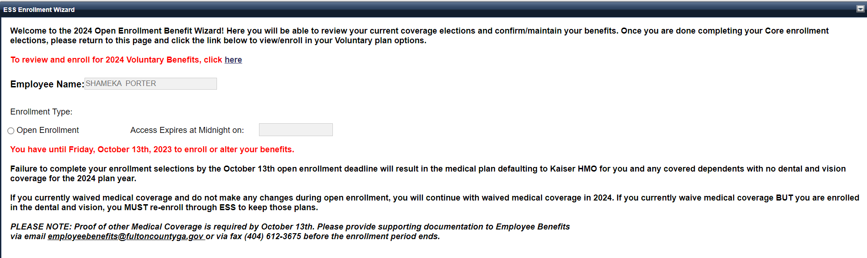
Voluntary Benefits Open Enrollment
September 25th – October 13th, 2023
ESS will link you to enroll in your Voluntary Benefits through a single sign on!
Please complete your core and voluntary benefits so that you can receive two open enrollment confirmations
**All Voluntary plans require you to re-enroll each year, even if you do not plan on making changes.

Slide 59

Questions
?

Slide 60

Next Steps
Watch your work email for Fulco News announcements
Visit the For Employees Facebook page
Visit the Benefits page on Employee Central
Visit the Open Enrollment page on the County’s website

